Slide 1
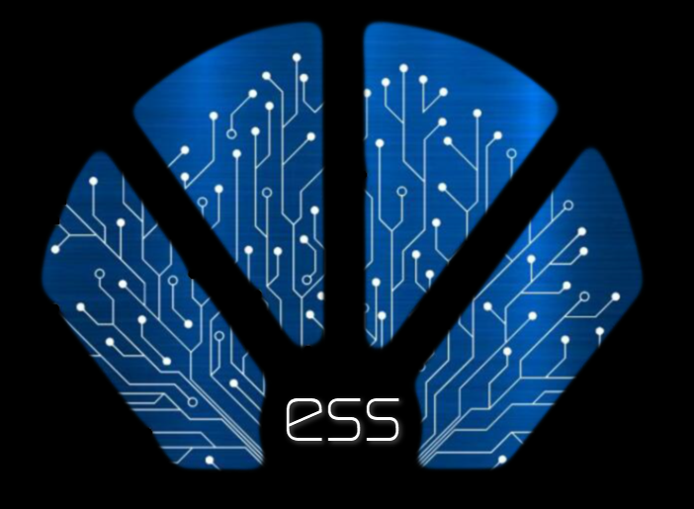
EdgeS
EdgeScript & EdgeShell “esh”
David Simmons
Smallscript LLC, © 2019

Slide 2
Who am I?
David Simmons – a “few years” developing languages
What
Where
Basic and 6812 assembler
  NBS Net Switches
Object-C
  (Lisp, Forth, Snobol, APL, Unix systems, etc)
Agile Object System Family of V8 like VMs
  Smalltalk since 1991
  AppleScript, and various other Apple/IBM Tech
  Object Databases
  S# since 1998
.NET CLR, Mobile, and Other Runtimes
  VB, JavaScript, C#, PowerShell
AfBox – EdgeS
  EdgeScript, EdgeShell
NBS – NIST 1976-1980s
  NBS Net
U of MD NSF SRC
QKS – 1990s AOS, Apple -> Smallscript (various Linux)
Microsoft Architect 2005-2014
Smallscript 2015-present

Slide 3
This talk is about something called
EdgeS
Built with Aos® Family Execution Engine Coff Box Technology, first released in 1992.
Short form “AfBox Technology”

Slide 4
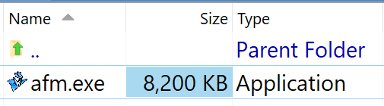
How is it deployed and structured?
  no install to run
    no force linked so/dlls
  single coff binary
    default-name “afm.exe”
    12MB working set
      8MB shared
    30ms start-to-exit
    6ms+ url page serving
Similar to BusyBox for embedded
AfBox enables EdgeS to be delivered as a single multi-functional binary
purpose built for developing and delivering software using IIoT and Edge standards
It is an alternative to using full-stack systems and their overhead

Slide 5
When run, what is the execution architecture?
An activity could be concurrent things like a cmd or a web-page-request …
sqlite
engine
Telemetry
&
Diagnostics
In each RunSpace there are always 2+ tasks
runspace dispatcher
iocp kernel scheduler
stddbg
Activity (iocp)
Activity (iocp)
…
stderr
Task (fiber)
…
iocp
workers
os-host log
task-pools
(language instance) RunSpace (Thread)
…
io streams
AfBox EE (Process)

Slide 6
Great. So what’s inside that makes it useful?
EdgeScript
TCL lex based extensible language cmd suite; scm-package based module file-system
ess
rfs
repo file system
TCL Lex Core
fossil-scm
Core System APIs
builtin filesystem
regex
markdown
sqlite
OS Services
xml
http + sockets
zip
telemetry diagnostics
NTFS …
xjson
console-shell api
pthread api
openssl
PAL
iocp
AfBox Execution Engine (EE)
EdgeScript language, formerly TSL, is a TCL lex transpiler on AfBox multi-language object architecture

Slide 7
Hmm, so how are programs organized?
The hard stuff:
versions, packages, updates, deployment, configuration, …
package-module management is scm-based using sqlite
this-plist
this-activity
workspace
this-io
this-task
~/.af/
user-home
.afconf
./bin/essc/cmds
.afws (workspace db)
.af/
  repo.afr (symlink)
  bin/
    essc/cmds
  etc/
    auth/
    certs/
    var/
  lib/
  opt/pkg
sites/default/
cmd module
opt/ modules …
git-scm
fossil
shell
repo.afr
sqlite
pkgs → repo branch
app
directory patterns adopt familiar names
::global –> module [mixins ]
Web Server Site
this-site, this-site.db, this.http, this.url, this.acl, this.session

Slide 8
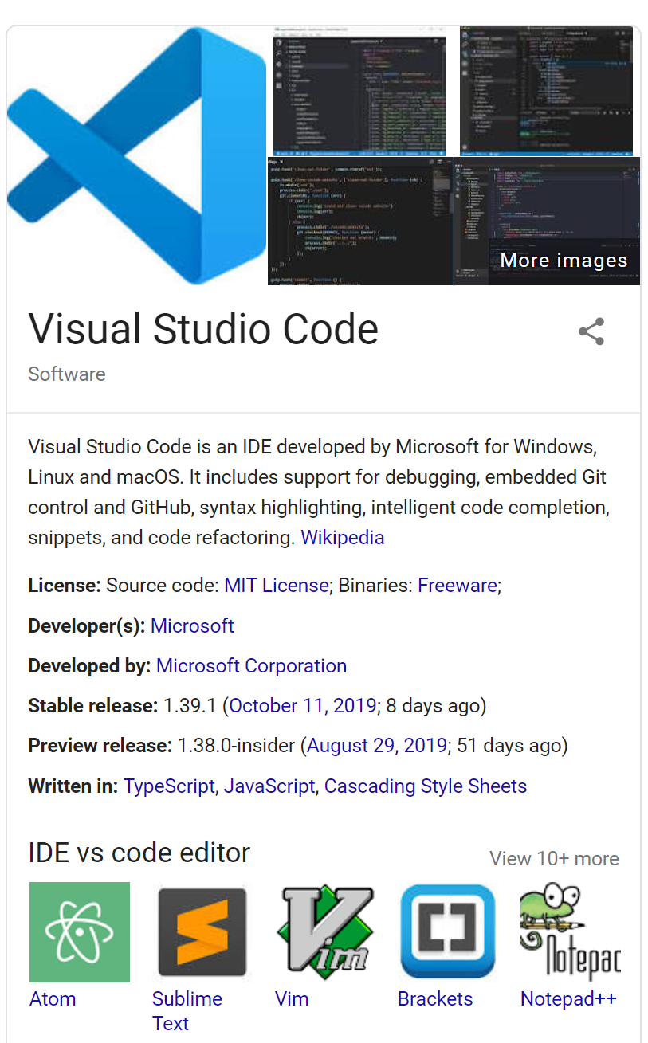
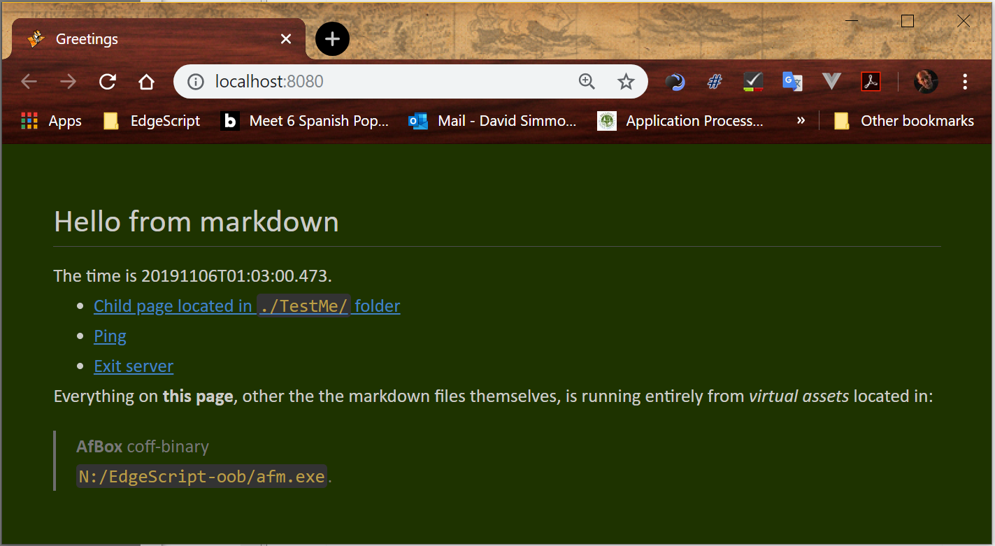
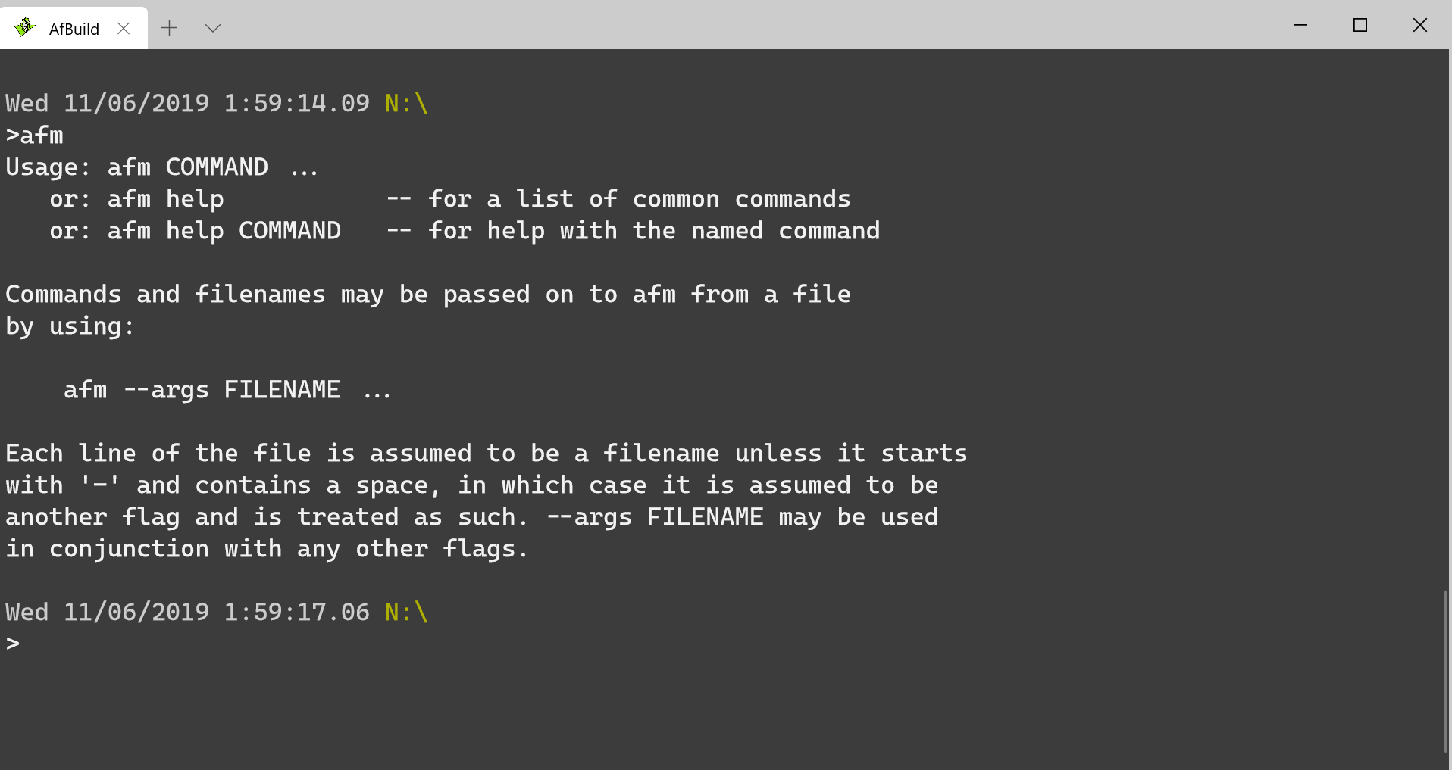
Enough talk, let’s experience code

Slide 9
Can I get a copy to try?
Within the next week or so
  https://edges.sm.st
    alt:
      https://edgescript.io
      https://edgescript.dev

Slide 10
Closing
Q & A

