Slide 1
Multicom – FlightAware’s Alert Delivery System
Mary Ryan Gilmore
TCL Conference 2019

Slide 2
What is Multicom?
High performance alert delivery application
Reads in a stream of 35 million flight event messages per day (that’s 400 updates per second on average)
Matches the events against more than 440,000 alert triggers
Sends more than 300,000 alerts each day
Notes:
Multicom is a high performance alert delivery application that is written in TCL. The system reads in a stream of 35 million flight event messages per day (that’s 400 updates per second on average), matches the event against more than 440,000 alert triggers, and sends more than 300,000 alerts each day.

Slide 3
Using TCL Packages to Improve Performance
As FlightAware gains access to more data sources, the number of events processed per day is only increasing
Improved performance by introducing sqlite and sqlbird
Improved durability by introducing tclrmq and zookeepertcl
Notes:
As FlightAware gains access to more data sources, the number of events processed per day is only increasing. Sometimes the change is gradual and sometimes it is very sudden and fast. Recently, FlightAware gained access to a new data source that gave us position messages all over the globe. This was exciting for the company, but detrimental to Multicom. With this new data feed, Multicom could no longer keep up the input of data in realtime. We had to quickly come up with a way to address the immediate shortfall, and we had to examine the system’s weaknesses in order to make it more performant. In order to address the performance issue, we used a number of TCL libraries such as sqlite and sqlbird. With this upgrade, we saw a significant performance boost, and our code became much more readable. Since this catastrophe, we are constantly looking for more ways to increase reliability and performance in order to easily accommodate more events. As a result, we have successfully introduced even more TCL technology to Multicom such as tclrmq and zookeepertcl. This paper will review the basic design of the system, and how we have used many different TCL packages to improve performance and durability.

Slide 4
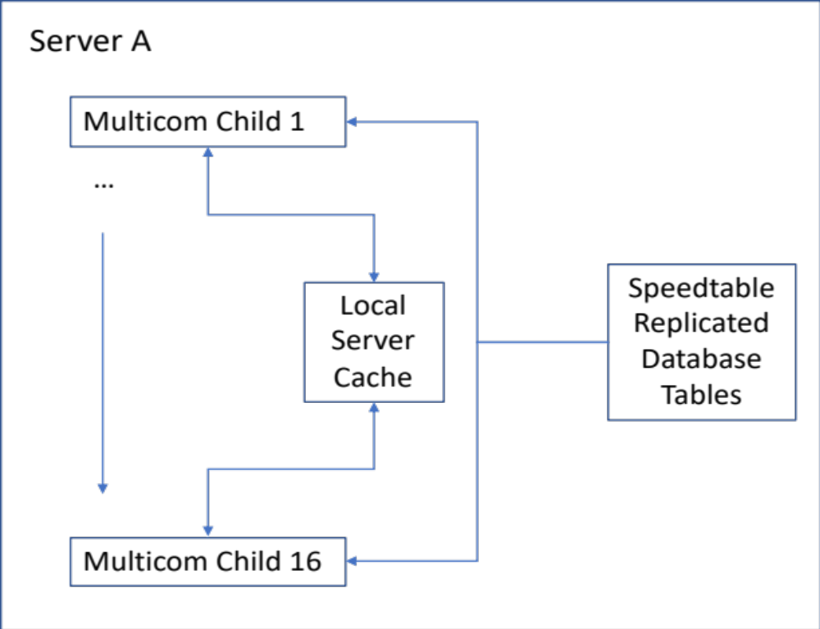
Old Multicom Design
Before sqlite and sqlbird were introduced, it ran on 3 servers with 16 children on each server (for 48 children total)
Notes:
The main system that consumes event messages and matches them to user’s alert triggers is run on 3 separate servers with 16 children on each server (for 48 children total). The flight event messages are hashed and equally distributed among all of the children. In the initial design, we used speedtables for caching, and all children wrote to and read from the same cache. We also used speedtables to replicate important database tables, such as the table that holds all of the alert triggers.

Slide 5
Problems with Speedtables Design
Does not have an “OR” functionality like postgres
There was a lot of write contention on the speedtable cache because all 16 of the children on one server where attempting to write to it

Slide 6
Response Following Sudden Event Data Increase
We threw more servers at the problem
We started running 96 child processes across 6 servers
Notes:
After we realized that introducing a new data source would debilitate the existing Mutlicom system, we needed a way to quickly resolve the issue so that we could have more time to address performance issues. We did this by throwing more servers at the problem. So instead of running 48 child processes across 3 servers, we started running 96 child processes across 6 servers. While this solved the original issue just fine, deploying new code across 6 servers became cumbersome. In addition, we knew we had major issues that we could address to make the system faster and more reliable.

Slide 7
Introducing Sqlite and Sqlbird
Sqlite solved the “OR” problem
(speedtables)
foreach field {base_id ident reg origin destination aircrafttype} {
set search_list [list [list match $field $data($field)] {true enabled}]
$::st(mc_trigger_tracking) search -compare $search_list -array trigger -code {
…
}
}
(sqlbird)
set sql “SELECT * FROM mc_trigger_tracking WHERE ident = :data(ident) OR reg = :data(reg) OR origin = :data(origin) OR destination = :data(destination) OR aircrafttpye = :data(aircrafttype)”
sqlbird::select $sql trigger {
…
}
Notes:
The main issue that we encountered using speedtables was that there was no basic “OR” functionality. In order to get around this issue, we would have to run multiple speedtable queries. This created ugly code and the query total query time was very long.
This is the reason why we started to explore using sqlite. Sqlite syntax is almost exactly like postgres, so it had the basic “OR” functionality that we were looking for, among many other useful syntax features. The language was also already widely used at Flightaware, because we have a postgres database server. We immediately started using sqlite for caching, and we reconfigured each child to write to and read from its own cache in order to eliminate the write contention.
We also wanted to use sqlite for database replication as well, so we turned to sqlbird, which was bran new at the time. Sqlbird is a sqlite database table and view replicator that allows us to store database information locally for quick access. Any process running on a server can access the replicated sqlbird tables in read-only mode, and sqlbird updates all of the tables/views in a configurable time interval.

Slide 8
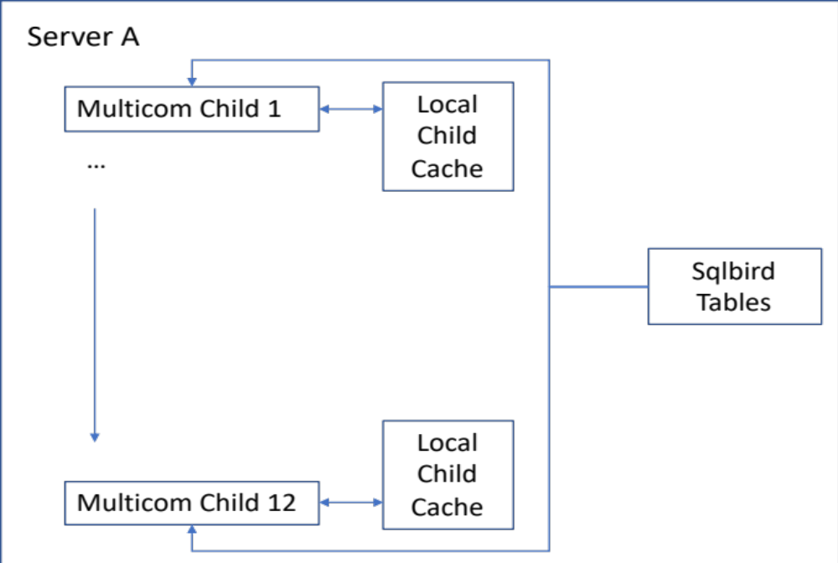
New Multicom Design
After sqlite and sqlbird were introduced, it ran on 2 servers with 12 children on each server (for 24 children total)
Notes:
Overall this design change and move to using sqlite was extremely successful for us. Along with some other small design changes, this enabled us to handle the new event data on only 2 servers with 12 children each (for 24 children total). This gave us a lot of room for future growth and allowed us to spend time addressing durability issues. It also significantly improved readability of our code.

Slide 9
The New Problem: Database Dependence
New company expectation that if the database goes down, your application does not
Mutlicom was using a database table as a queue
Database
Email delivery channel
Queued alerts
Android delivery channel
Apple push notification delivery channel
Notes:
After sqlbird had such a great rollout in Multicom, we rolled it out to almost all of the systems at FlightAware. This means that whenever we had database problems, every application that accessed sqlbird exclusively instead of the database was almost completely unaffected. This prompted a new expectation for applications at FlightAware – if the database goes down, your application does not.
This new expectation challenged Multicom yet again, because whenever Multicom would queue an alert to be sent, it used a database table for a queue. The main queuing system would insert a line into this table for every alert that we wanted to queue for send out. Then we had delivery channel daemons (5 total – 1 for every media type) that would continuously query this table and process any queued alerts that have not been processed. As a result, these additional reads and writes significantly increased our load on the main database. This was a result of legacy code that has been around for years, and we knew for a while that we needed to make this better. It was time to stop using the database table as a queue, and start using a real queue.

Slide 10
Using Tclrmq to Enable us to Use RabbitMQ
Email queue
Email delivery channel
Queued alerts
Android queue
Android delivery channel
Apple push notification queue
Apple push notification delivery channel
Notes:
We decided to use tclrmq in order to help us with this transition. Using this package, we configured our own Mutlicom RabbitMQ virtual host with one queue for each delivery channel. The main system would write to each queue, depending on what channel the user configures for each of there alerts. Then each delivery channel daemon will receive these messages directly through RMQ without any database access. We queue the messages as a key/value list and read them on the delivery channel daemon side as an array for easy access.

Slide 11
Using Zookeepertcl to Store PITR
Another thing that we used the database for was storing point in time references for each child process
Moved this functionality to zookeeper
Notes:
Another thing that we used the database for was storing point in time references for each child process. This enabled us to restart Multicom and start at the same event messages that we just left off on. We found that zookeeper would be a better place to store this information, so we used zookeepertcl to make that change.
Overall I found the tclrmq package, and zookeepertcl package to be very well documented and easy to use. These particular packages have a lot of value at FlightAware because they are used in critical technology that will have a very large effect in case of any failure. Whenever I found any issues with either package, I got serious attention and timely fixes. Although these packages are not part of the native language, the support that I got for them through the FlightAware organization was very good.

Slide 12
Conclusion
We attribute a lot of Multicom’s continued growth and success to new TCL libraries such as sqlite, sqlbird, tclrmq, and zookeepertcl
Look forward to learning about new ways that we can use TCL to improve this system
Notes:
Multicom has grown significantly as a system within just the past 2 years. In this time, it has faced significant hurdles from being completely overrun by a sudden influx of data, to having to meet the company’s expectations by continuing to run even when the database is not. Although the trials have been significant, we attribute a lot of Multicom’s continued growth and success to new TCL libraries such as sqlite, sqlbird, tclrmq, and zookeepertcl. These libraries have been instrumental in allowing this system to grow, and we look forward to learning about new ways that we can use TCL to improve this system.

