Slide 1
Modern Dataflow in Experimental Nuclear Science (and Tcl).
Ron Fox, Giordano Cerizza
Sean Liddick, Aaron Chester

Slide 2
Talk Outline
A bit about me and my Tcl history
What is the National Superconducting Cyclotron Laboratory (NSCL)
How data taking has evolved in experimental nuclear science
E17011 an experiment with modern electronics – why it’s computationally demanding
Parallel resources available to us
Message Passing Interface (MPI) and Tcl
  Intro to MPI
  Existing Tcl support
  Tcl-Ish support we did.
Applying MPITcl to an existing application
What this means for experimental nuclear science at the NSCL

Slide 3
Tcl and me.
Introduced Tcl/Tk at the National Superconducting Cyclotron Lab (NSCL) back in the 4.x days.
Plugged into the community with a talk in New Orleans (Tcl 2004)
  https://www.tcl.tk/community/tcl2004/Papers/RonFox/
  NSCLSpecTcl – Histogramming package for experimental nuclear science.
Tcl/Tk conference proceedings editor from Tcl2005 and on if memory serves.
Tcl plays an important role in the NSCL experimental program.

Slide 4
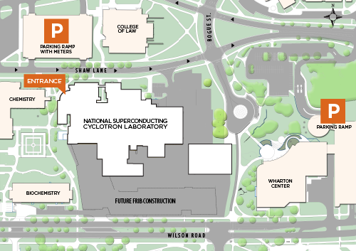
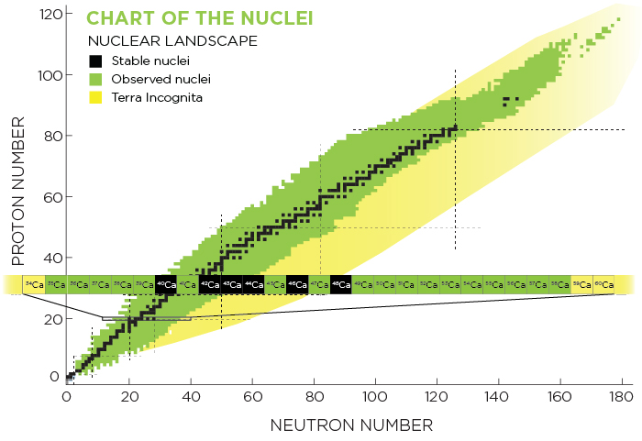
The National Superconducting Cyclotron Lab.
Located at Michigan State University
Funded by the National Science Foundation as a user facility
Explore the properties of nuclear
unstable nucleii
Why and how do certain isotopes
form.
Where do the heavy elements come
from?
http://www.nscl.msu.edu

Slide 5
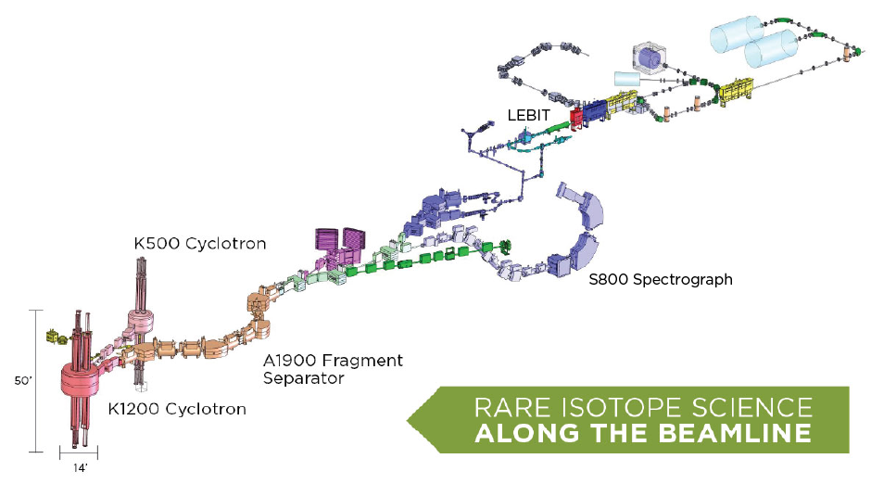
NSCL Block Diagram

Slide 6
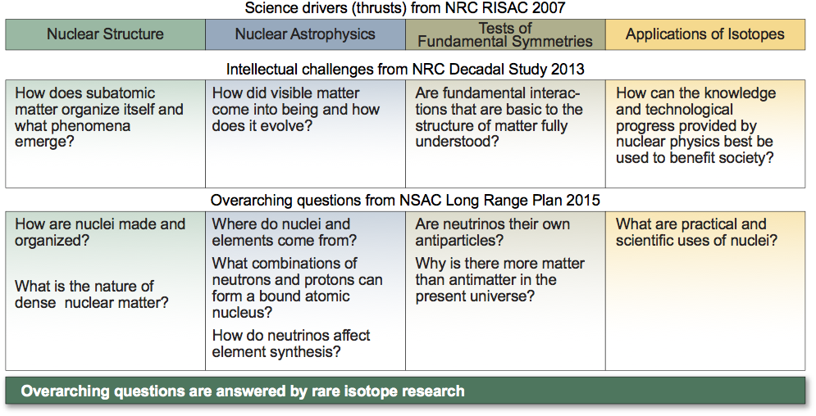
Science drivers for Rare Isotope Research

Slide 7
Data Acquisition – old school (analog)
Shaping
Amp
ADC, TDC, QDC
Detector
Preamp.
Discrimination
Logic and timing
Important point – dead-times for a conversion are microseconds

Slide 8
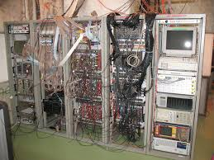
Data Acquisition – old school (analog)
Detector signals
Pre-amplification
Shaping/amplification
Timing/triggering
Digitizing modules
Each digitizing module
Gives one value per input:
Pulse height
Pulse charge integration
Pulse timing relative to
some reference time.

Slide 9
Modern Data Acquisition (digital)
Detector
Preamp.
Flash ADC (100-500MHz)
Memory
Large FPGA

Slide 10
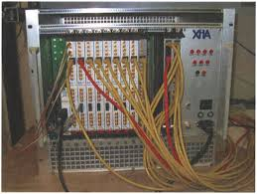
Modern data acquisition (100MHz – 500MHz)
Detector Signals
Preamplification
Digitization
Firmware can extract
  Pulse ht.
  Charge integral
  Timing
Keeping waveforms allows
experiments that can’t be
done with analog electronics.
Wave form analysis is
computationally demanding
Wave forms bloat the data

Slide 11
E17011
Scheduled to run in January.
  Look at beta decay of 80Ga -> 80Ge
  Look at the lifetime of the 0₂⁺ -> 0₁⁺
  Lifetime tell us something about the difference in the radius of the charge distribution of the two states.
200MB/second sustained – though modest trigger rate (~3KHz).
Will take 100TB+ of data
Need good online and nearline analysis:
  Are the detectors working.
  Are we seeing what we think we should be seeing.
  Should we ask for additional (discretionary time).

Slide 12
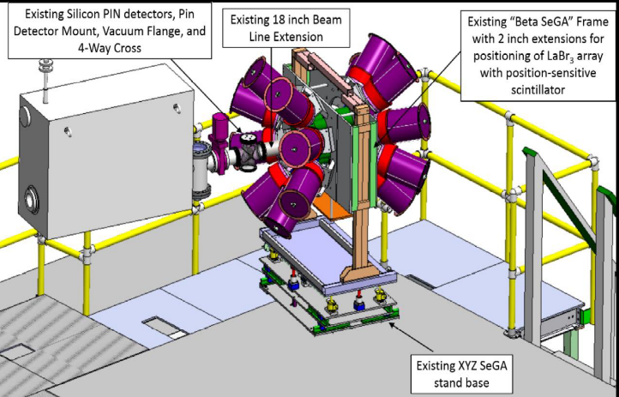
E17011 – block diagram
Sketch of experiment
Ge
LaBr₃
Ge
CeBr₃
Pixilated
PMT
86Kr primary beam
104MeV/A
80Ga
80Ga β- decays to 80Ge
Si
PIN stack
LaBr₃
Ge
9Be
Production target
Beam particle
ID
LaBr₃
Ron Fox Tcl 2019, Houston, TX
, Slide 12

Slide 13
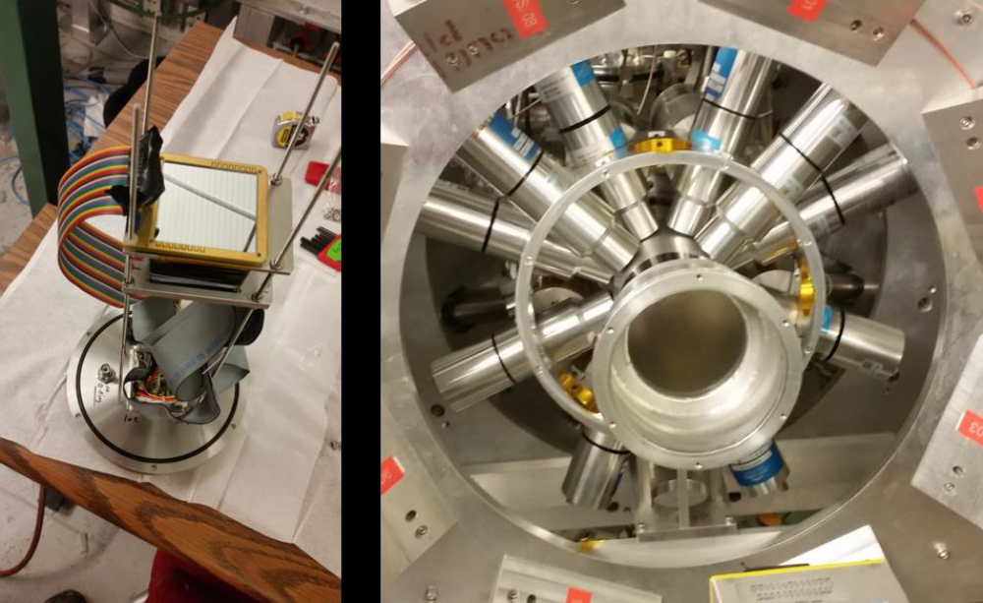
Pictures pictures (CeBr₃ and LaBr₃ array)

Slide 14
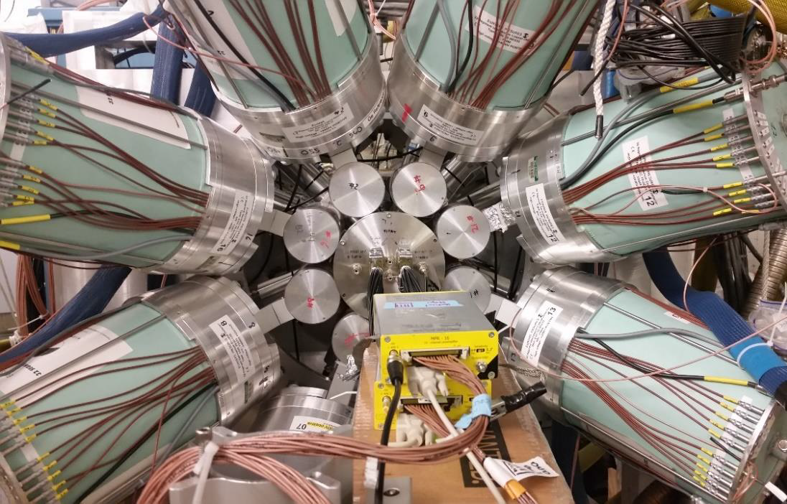
More pictures Ge Array (SeGA)

Slide 15
What happens to the implanted ions.
⁸⁰Ga decays to ⁸⁰Ge by β- decay.
  This decay is also detected in the CeBr₃ detector
  This decay populates several energy levels of ⁸⁰Ge
Of interest are the decays that populate the 0₂⁺ state.
  This eventually de-excites to the 0₁⁺ state emitting a γ-ray (detected by the LaBr₃ array and/or SeGA) and and a conversion electron.
  The conversion electron produced by that decay is sensed by the CeBr₃
Well it’s not actually eventually.
  Similar de-excitations have half lives of about 50ns.
  We want the actual ½ life.
This is a short ½ life. How to measure it.
  Digitize the pulses in the CeBr₃
    Sum signal at 500MHz
    pixels at 250MHz
    Trace lengths of a few microseconds (on order 100 samples).

Slide 16
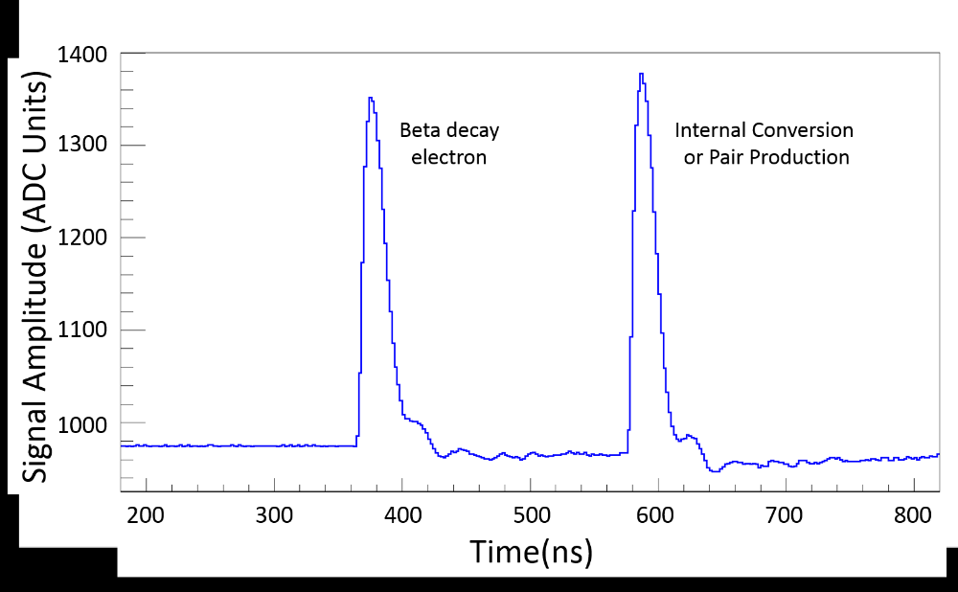
Sample trace from a similar experiment
Decay time
Conversion e⁻ energy

Slide 17
Where does that 200MB/sec come from?
Since most of the CeBr3 detector lights up for a hit we about 200traces/event (maximal pixel is ‘where’ the event occurred).
The data rate is dominated by traces from the CeBr3.
Trigger rates may be 3KHz (modest)
Data transfer rates will be a sustained 200MB/seconds.
To see if the experiment is “working” we need to do some processing on all this stuff.
  Determine if traces are single or double pulses.
  Determine the characteristics of the pulse(s) – time and height.
Good news though: Taking traces meas we can do the experiment.
This experiment is really hard to do with old school electronics.

Slide 18
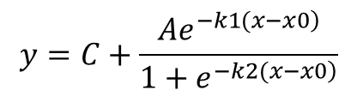
Data Flow:
$$y=C+\frac{Ae^{\left.−k1(x−x0\right)}}{1+e^{\left.−k2(x−x0\right)}}$$
Online storage
100TB
XIA digitizers Crate 1
Append
Fits for 1,
2 pulses to
Sum signal.
Event builder
Event
Selection
(PIN Based)
XIA
Digitizers
Crate 2
Periodic
rsync
Data emitted
Have 50Mhz
timestamps
Synchronized to
< 1ns.
130 TB Cephs
Analysis Storage
Threaded
NSCLSpecTcl
(see later)
Near-line analysis

Slide 19
Online analysis
Fit the sum traces from the CeBr3.
  Fit for both single and double pulses.
  Use a heuristic to determine if the pulses are single or double.
Make a pile of histograms (NSCLSpecTcl) and look at them online
Keep up with the incoming data rate.
NOTE: Each fit costs 3.5ms to do using GSL’s Levenberg-Marquardt.
Serial code isn’t going to cut it.

Slide 20
Near-line Analysis – want to keep up with incoming data rate or better
Fit the remaining traces in the CeBr₃
  Are they single or double pulses (heuristic)?
  If double pulses extract the time difference as a parameter for histogramming.
Correlate implantation events with decay events.
  Using position and particle ID information
  Timing between implantation and decay.
These are computationally intensive (e.g. the fit is about 3.5ms/event). To make decisions about the experiment we need to analyze the data already taken faster than acquisition.
Serial code isn’t going to cut it ~2500 cores just for fitting all traces.

Slide 21
Parallel resources at the NSCL available to E17011
Three high core count systems:
  1 26 core system. (Xeon E5-2690 v4 @ 2.60GHz)
  2 40 core systems (Xeon Gold 6148 @ 2.4GHz) – bought for this experiment
  Used for online data flow and interactive ‘near-line’ analysis.
Modest Linux cluster
  360 cores of various ages
  Used for non-interactive ‘near-line’ partial analysis.
That’s not going to be enough (to do the fitting of all signals at data rates needs about 2500cores).
no GPU coprocessors ☹

Slide 22
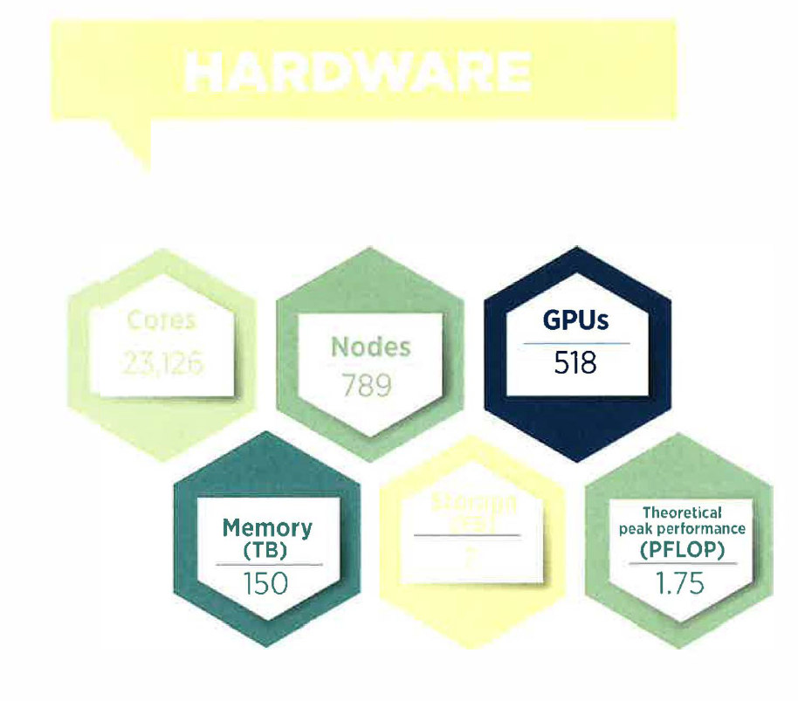
MSU Institute for Cyber Enabled Research (ICER)
Naturally we’ve lusted after
sought ways to leverage this
resource for near-line and maybe
even online analysis.
Work to containerize our apps is
done (thank you singularity)
Scheduling, however can be an
issue: NSCL resources can be
dedicated to E17011, ICER is
shared across all university users.
Cores
23,126
Storage
7 PB

Slide 23
Structure of event analysis parallel programs
worker
Sort
output
src
Data distribution
.
.
.
Sink
worker

Slide 24
Meeting these needs.
Different types of parallelism
  Threaded parallelism for the online/interactive stuff.
  Distributed parallelism for near-line non-interactive stuff.
Tools to make parallelization simpler
Fitting:
  Support for GPU ‘accelerated’ fitting residual and Jacobian computation ☹
  Machine learning for single/double pulse determination – most traces are single pulses
Example trace fitting the sum signal: same program threaded/cluster

Slide 25
MPI – cluster distributed parallel computing
MPI - Message Passing Interface standard for writing distributed parallel programs.
  OpenMPI https://www.open-mpi.org/
  MPICH https://www.mpich.org/
Multiple instances of the same process run in parallel.
  Each process as a rank identifying it.
  Processes can target messages to specific ranks.
  Communicators can be formed to link groups of processes together.
Messages require:
  Rank – who we’re sending to but:
  Communicator – defines the process group in which the rank has meaning (MPI_COMM_WORLD – the entire application is pre-defined).
  A Tag (integer)
  Message data.
  Type of data in the message (message data are strongly typed)
  Number of items of that type being sent.

Slide 26
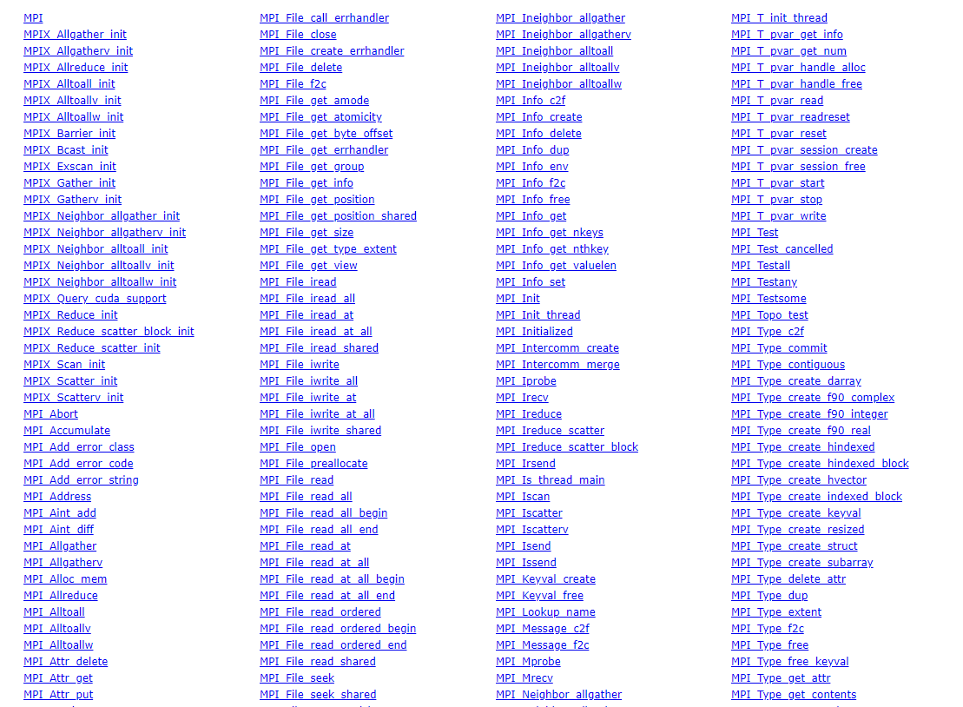
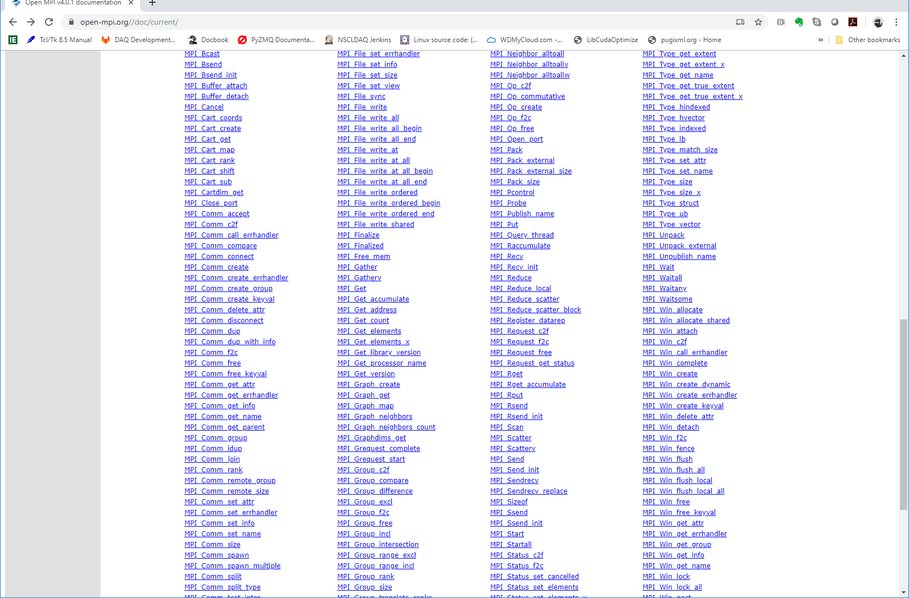
The MPI API is large and complex:
… and there’s more…much more.

Slide 27
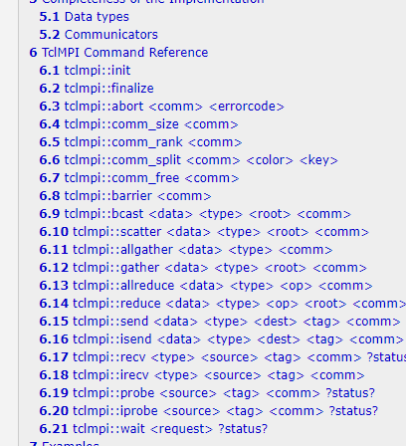
Approaches for encapsulating MPI
Subset wrapping
Straight encapsulation of the MPI function interface.
  Approach taken by Axel Kohlmeyer for the mpi package
  See e.g. https://core.tcl-lang.org/jenglish/gutter/packages/mpi.html
Still captures the flavor of the MPI API
Still exposes explicitly the MPI API subset
Still exposes the complexity.

Slide 28
What do Tcl MPI applications want to do:
Send scripts executed in other ranks.
  Special case of send to all or all others.
Send data that can be handled by other ranks via callbacks.
  Again special case of send to all or to others.
Tcl – We know in advance: Everything has a string representation.
Binary data – may be sent around by the C/C++ part of the application for C/C++ parts of the application to work on needs a way for that code to shove the TclMPI event handling stuff aside and take over.

Slide 29
mpitcl - MPI aware tcl shell.
Provides MPI aware tclsh.
  Must be run from mpirun.
All ranks run this.
Rank 0 is special – the ‘master’ interpreter it takes input from stdin (normally a file for cluster batch jobs).
Provides all processes with the mpi namespace in which the mpi command ensemble lives.
Rank 0 runs a thread to hoist MPI messages received to the event loop (vwait).
Ranks other than zero run a main loop that accepts MPI messages and act on them under the assumption they come from mpitcl.
MPI Tags are used to transparently dispatch messages to appropriate handlers.

Slide 30
mpi::mpi command ensemble subcommands:
size - How many processes are in the application.
rank – What is my rank in MPI_COMM_WORLD
execute where script – Executes a script in the rank(s) defined by where where is
a rank number “all” or “others”
send where data - sends the data to where
handle script - specifies script to handle data received. The script
receives two parameters: sender rank and the data.
stopnotifier - only legal in rank 0 – stops the event notifier thread.
startnotifier - only legal in rank 0 – starts the notifier thread again.

Slide 31
Sample mpitcl scripts:
proc receiver {rank data} {
puts "Received from $rank '$data'"
incr ::slaves -1
}
set slaves [mpi::mpi size]
incr slaves -1; # number of slave processes.
mpi::mpi handle receiver
mpi::mpi execute others {
mpi::mpi send 0 "Rank [mpi::mpi rank] is alive"
}
while {$slaves} {
vwait slaves
}
mpi::mpi stopnotifier
mpi::mpi execute all exit
mpi::mpi stop notifier
mpi::mpi send all exit
Mimimal MPI
script
Soliciting/getting data from workers

Slide 32
Applying tclmpi – The Circle is complete.
NSCLSpectcl
Structure
Parallelization of the interactive version (threaded).
Creating a batch NSCLSpecTcl and using it with tclmpi.

Slide 33
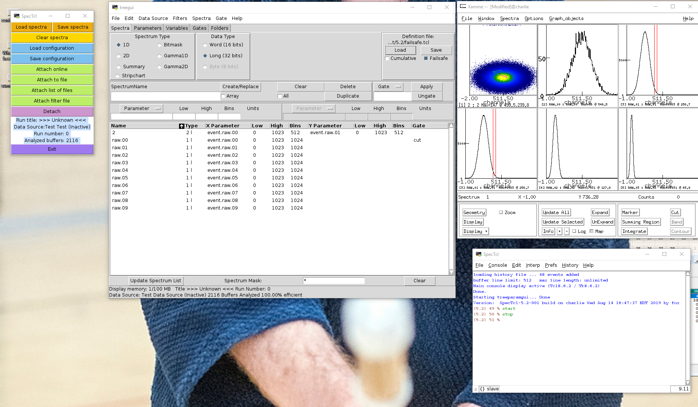
NSCLSpecTcl is highly interactive

Slide 34
Simplified NSCLSpecTcl structure and parallelization approaches.
Data Source
(File or pipe)
Extended
Tcl/Tk
Interpreter
Blocks of data
Configures
And controls
High level
Buffer Decoding
Raw events
User Event
Processing
pipeline
Creates
Analysis
config.
Raw and synthetic parameters
Gating and
Histogramming

Slide 35
Threaded Parallelism (Giordano Cerizza)
Data Source
(File or pipe)
Extended
Tcl/Tk
Interpreter
Blocks of data
Configures
And starts
High level
Buffer Decoding
High level
Buffer Decoding
Raw events
…
User Event
Processing
pipeline
User Event
Processing
pipeline
Creates
Analysis
config.
Decoded and synthetic parameters
Gating and
Histogramming
User code must be thread-safe

Slide 36
Threaded Spectcl performance
Roll off is at the performance limit of the SSD that contained the data.
Analysis pipeline for this case is simple compared with E17011’s.
Good scaling up until SSD transfer limits.

Slide 37
MPI parallelism?
We can recruit more cores if the application scales.
We don’t have to worry about thread safety since it’s process parallelism.
With an assist from container technology (e.g. singularity) we can get outside the NSCL to supercomputer centers (or ICER e.g.) with even more cores.
BUT In almost all cases cluster computing doesn’t allow dynamic interactivity.
  Needed to turn NSCLSpecTcl into a batch program.
  Needed to figure out how to easily parallelize it.
  This is the original target of mpitcl.

Slide 38
MPI NSCLSpecTcl
Each process is a complete batch NSCLSpecTcl
  Batch NSCLSpecTcl is three packages
    spectcl – the base application code.
    mpispectcl MPI data sources and sinks.
    A user supplied package implementing the processing pipeline.
  Batch/MPI NSCLSpecTcl has generalized data sources and sinks. analyze command sends blocks of events from source to sink. I’ve implemented:
    Source –file.
    Source – MPI (for workers – requests block of data from rank 0).
    Sink -- Analysis
    Sink – MPI (Distributes blocks of data to workers using MPI source).
Rank 0 :
  Tells each process (including itself) to read in the configuration scripts.
  Tells other process to use an MPI Source and Analysis sink
  Tells itself to use a file data source and MPI sink.
  Tells everyone to start analyzing data.
When analysis is complete Rank 0
  Tells all other processes to send it spectrum data.
  Sums the spectra into total spectra
  Writes them out for visualization.

Slide 39
What this looks like:
mpi::mpi execute all {
package require spectcl
package require mpispectcl
package require MyPipeline; # User event processing code is here.
source defs.tcl
}
mpi::mpi execute others {
mpisource
analysissink
}
filesource run-0003-00.evt
mpisink
mpi::mpi stopnotifier
mpi::mpi execute others analyze
analyze
mpi::mpi startnotifier

Slide 40
Getting the data back:
set l [spectrum -list]
set f [open spectra.dat w]
foreach spectrum $l {
set name [lindex $spectrum 1]
getSpectrumFromWorkers $name
swrite -format ascii $f $name; # Writes a histo to file.
}
close $f

Slide 41
Summing a spectrum from worker nodes.
proc addData {name src data} {; # sums the histo from 1 worker into the local histo.
foreach datum $data {
set value [lindex $datum end]
set coords [lrange $datum 0 end-1]
set current [channel -get $name $coords]
incr current $value
channel -set $name $coords $current
}
incr ::expected -1
}
proc getSpectrumFromWorkers name {
mpi::mpi handle [list addData $name]
set ::expected [mpi::mpi size]
incr ::expected -1;
set script "mpi::mpi send 0; # Care must be taken to ensure substitutions are done
append script "\[“ ; # in the right process.
append script "scontents $name]"
mpi::mpi execute others $script
while {$::expected > 0} {
vwait ::expected;
}
}

Slide 42
Does this work?
10Gbyte file with 2,754,450 events.
Workers | Time | MB/sec | Events/sec
1 | 25.4 | 403.1496 | 108442.91
2 | 13.5 | 758.5185 | 204033.33
4 | 6.6 | 1551.515 | 417340.91
8 | 3.9 | 2625.641 | 706269.23
2.6Gbytes/sec is interconnect saturation (dual 10GBit/sec ethernet)
Event processing in the actual experiment
will be more complex but we can scale to more workers.

Slide 43
Conclusions
NSCL’s Transition to modern, digital nuclear electronics poses problems for online and near-line data analysis.
Experiments will increasingly require parallelism in online and near-line data handling:
  Software tools to make it easy for naïve users to make use of parallelism by plugging in their event analysis code.
  Large core count systems for interactive, online analysis (threaded parallel).
  Clusters dedicated to the running experiment for near-line analysis (distributed parallel).
  High speed interconnects to support the data flow bandwidth.
  Large, multi-petabyte storage that’s fast with fast interconnects.
E17011 provides a laboratory to explore the techniques we’ll need to apply to modern experiments.
mpitcl is one technique to simplify parallel programming for “the masses”
  Easly retrofitted a highly interactive, complex serial analysis program (2 days work)
  Got scaling up to the interconnect bandwidth.

