Slide 1
Popeye
Flight Tracking with SQLite

Slide 2
Keeping track of flights
FlightAware needs a fast way to keep track of flights actually in the air.
FlightAware receives input from thousands of sources, and generates a consistent stream of flight events.
  This involves sorcery that will not be addressed here.
These have to be turned into a view of what's currently in the air.
This view needs to be up to date and super fast to query.

Slide 3
Birdseye
For most of history this has been kept in speedtables.
  This is Birdseye.
This has worked pretty well, but has some problems.
  There's more flights all the time, and reading and interpreting the stream of flight data in Tcl is getting tough.
  Speedtables are volatile, so frequent snapshots need to be taken, and starting or restarting a Birdseye server is kind of slow.

Slide 4
Controlstream
Flight events are transmitted, stored, and archived in a format called "daystream".
  https://www.tcl.tk/community/tcl2017/assets/talk95/Paper.pdf
Each flight event (position, arrival, departure, etc...) is a separate line.
Each line are tab-separated key-value pairs.
First two pairs are a timestamp composed of seconds and a sequence number.

Slide 5
Controlstream
Example:
_c 1539354574 _s 10 type position ident WZZ1022 childID 126 _t b adhoc 1 adsb_category A3 adsb_version 2 airground A alt 370 alt_ft 37000 alt_gnss 38250 alt_src A bitmask 0 clock 1539354569 combid 1539354574-615 facility fAT-42bdf278-a9ba-412b-8bbf-9452990c3965 feed ADEPT7 feed_c 1539354569 feed_s 2546 flightlevel 370 fp WZZ1022-1539302978-ed-0003:5 gSource feed gs 507 hSource feed heading 130 heading_magnetic 127.6 hexid 471F61 lat 55.91468 lon 12.35473 mach 0.768 nac_p [...]
Zillions of these a second.

Slide 6
Controlstream
The daystream feed containing the canonical view of flight events is called "controlstream".
This is the "input" side of Birdseye

Slide 7
Trackstream
Clients, like webservers, query birdseye using a protocol called "trackstream".
  It's your basic query-response TCP/IP API, send a query and get a one-line (maybe a very long line) reply.
  Queries actually Tcl and look kind of like like Speedtable search queries.
    Trackstream was the inspiration for speedtables.
    Not quite the same, speedtable syntax is more database-like so Birdseye translates queries.
  Replies are almost always Tcl lists, except where they're tab-separated lists for some historic reason.

Slide 8
Eagle Eye
Build one to throw away
Eagle-Eye replaced Speedtables with a Cassandra cluster
Instead of having a bunch of Birdseye servers, and trackstream queries, clients would connect to Cassandra and make CQL queries.
Massively multithreaded controlstream reader to populate Cassandra.

Slide 9
Eagle Eye Problems
CQL is not as powerful as Speedtables API
  This was actually a surprise, it's less powerful than SQL, sure, but Speedtables is not even pretending to be SQL.
Massive write multiplication. You need a separate copy of a table for each "index".
Cassandra latency meant keeping a lot of duplicated state while reading controlstream, which meant startup delays as this state was restored.
Getting good performance for some queries required making many CQL queries in parallel, and changes to the webservers.
Basically, Cassandra is not a great tool for a general query engine.

Slide 10
Popeye
Popeye replaced Speedtables with SQLite
SQLite is non-volatile, so a popeye can be shut down and started up without delay.
SQL is far richer than Speedtables API (STAPI) or CQL
SQLite latency is low because there's no network I/O
  Still higher than speedtables, but not enough to be a killer.

Slide 11
Popeye - Input
Popeye replaced Tcl controlstream reader with one in C++
C++ is lower level than Tcl, but C++14 is pretty good.
Plus, we have revived a nice C++ Tcl wrapper library.
  https://github.com/flightaware/cpptcl
  Shannon's talk will cover this.

Slide 12
Popeye - Input
Can't practically query SQLite for keeping track of state for every flight data event, so some processing was simplified or deferred to the back end.
  Maintaining the bounding box is handled in a C++ map.
  Projected positions are just stored and filtered in trackstream.
Some state needs to be maintained, but occasional SQLite queries and caching results in maps is good enough.
  So no massive state restore at startup.

Slide 13
Popeye - Input
Generating SQL code for updating flight status was actually taking significant CPU time in C++ string operations.
  We walk the column list and build a tree, and only generate new SQL when a new leaf node is created.
  The tree is brute force and never pruned because it tops out at 1500-2000 unique statements.

Slide 14
Popeye - Output
We already had experience converting Speedtables queries to SQL
  "STAPI" - Speedtables API: maps queries to trackstream-style sockets, or PostgreSQL database
Doesn't actually use STAPI, because trackstream is not exactly speedtables, just similar.
Birdseye code was already translating trackstream to speedtables, this was modified to generate SQL.

Slide 15
Popeye - Trackstream
Example query
        search -inAir both -originOrDestination KTPA -withPositionsSince 999999 -unblock ""
Search flights, arriving or departing KTPA, with their track. But don't show blocked (hidden) flights.

Slide 16
Popeye - Trackstream
This generates some SQL
SELECT fp,[...],inflight.clock as clock,inflight.ident as ident FROM inflight LEFT JOIN blocked on inflight.ident = blocked.ident WHERE (orig = 'KTPA' OR dest = 'KTPA') AND inflight.clock > '1539346626' AND lat IS NOT NULL AND blocked.clock IS NULL ORDER BY clock DESC LIMIT 12800;
Then popeye runs over the resulting flights and builds a track for each aircraft:
SELECT lon, lat FROM positions WHERE fp = :fp AND clock > :withPositionsSince AND (gs <> 0 OR gs IS NULL) ORDER BY clock;

Slide 17
Popeye - Trackstream
And that produces a Tcl list
{ident SWA104 prefix {} type B737 suffix {} origin KDCA destination KTPA departureTime 1539351420 faFlightID SWA104-1539149199-airline-0115 waypoints {38.85 -77.04 [...] 27.98 -82.53} blocked 0 timeout ok timestamp 1539351989 firstPositionTime 1539351463 lowLatitude 38.57555 lowLongitude -77.46361 highLatitude 38.98889 highLongitude -77.04103 longitude -77.46361 latitude 38.57555 groundspeed 381 altitude 198 altitudeFeet 19800 altitudeStatus - updateType TZ altitudeChange D heading 206 arrivalTime 0 estimatedArrivalTime 1539358800 track {-77.041 38.872 -77.113 38.922 -77.164 38.973 -77.256 38.989 -77.35 38.977 -77.359 38.872 -77.344 38.764 -77.403 38.67 -77.464 38.576}} [...]

Slide 18
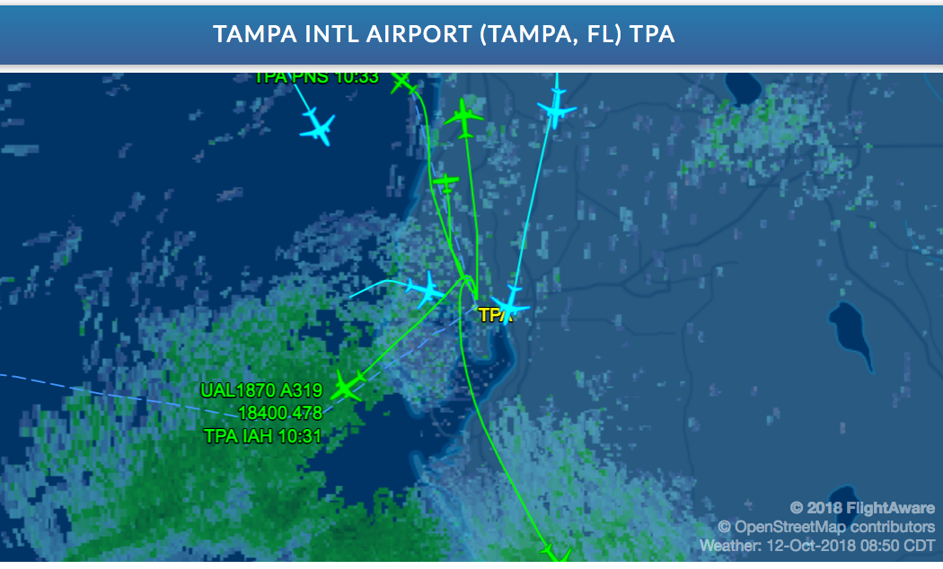
Resulting Webpage

Slide 19
Popeye - Trackstream
Then when you look at a particular flight:
info UAL735-1539101593-fa-0010
Which uses a somewhat simpler query:
select * from inflight where fp = :fp order by clock desc limit 1;
And produces:
ident UAL735 prefix {} type B738 suffix {} origin KTPA destination KIAD departureTime 1539352740 faFlightID UAL735-1539101593-fa-0010 waypoints {27.98 -82.53 [...] 38.95 -77.46} blocked 0 timeout ok timestamp 1539353470 firstPositionTime 1539352818 lowLatitude 28.00000 lowLongitude -82.64333 highLatitude 29.06889 highLongitude -82.52472 longitude -82.64333 latitude 29.06889 groundspeed 436 altitude 235 altitudeStatus {} altitudeFeet 23500 updateType TZ altitudeChange C heading 353 estimatedArrivalTime 1539359820

Slide 20
Popeye - Trackstream
And for the track:
get_track UAL735-1539101593-fa-0010
This hits the position history table:
SELECT clock, lon, lat, gs, alt, alt_ft, altChar, updateType, coalesce(cid,'---') cid, facility, altChange, heading FROM positions WHERE fp = :fp ORDER BY clock;
And produces:
{1539352818 -82.53333 28.00000 169 8.00 {} TZ --- KTPA D {} 800} {1539352911 -82.52472 28.08389 217 39.00 {} TZ --- KZJX C 5 3900} {1539352973 -82.52583 28.16639 275 69.00 {} TZ --- KZJX C 359 6900} {1539353035 -82.53806 28.24556 285 100.00 {} TZ --- KZJX C 352 10000} {1539353097 -82.55111 28.35778 322 115.00 {} TZ --- KZJX C 354 11500} {1539353159 -82.56167 28.46500 361 138.00 {} TZ --- KZJX C 355 13800} {1539353222 -82.57750 28.58417 398 160.00 {} TZ --- KZJX C 353 16000} {1539353284 -82.59194 28.69806 409 180.00 {} TZ --- KZJX C 354 18000} {1539353347 -82.61111 28.82444 422 201.00 {} TZ --- KZJX C 352 20100} {1539353408 -82.62695 28.94333 426 219.00 {} TZ --- KZJX C 353 21900} {1539353470 -82.64333 29.06889 436 235.00 {} TZ --- KZJX C 353 23500} {1539353532 -82.66000 29.19167 439 250.00 {} TZ --- KZJX C 353 25000}

Slide 21
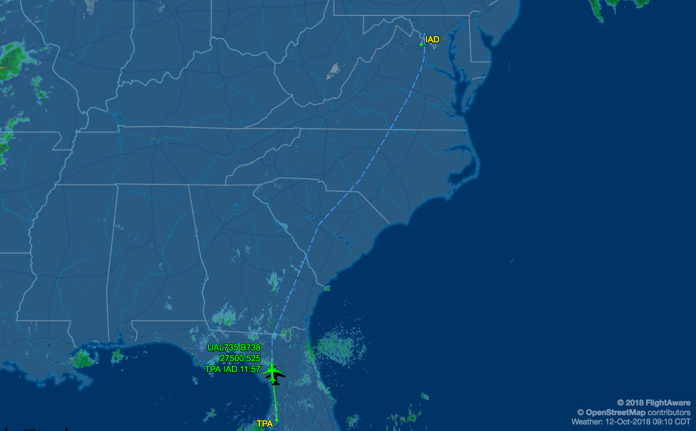
Resulting Webpage

Slide 22
Popeye - Trackstream
But that track information is kind of oldschool, so now we do:
get_track_kv UAL735-1539101593-fa-0010
Which uses a somewhat simpler query:
SELECT clock,lon,lat,gs,alt_ft,[...],nav_qnh,emergency FROM positions WHERE fp = :fp ORDER BY clock
Which produces:
{lon -82.53333 gs 169 alt_ft 800 clock 1539352818 heading {} lat 28.00000 updateType TZ facility KTPA}
{lon -82.52472 gs 217 alt_ft 3900 clock 1539352911 heading 5 lat 28.08389 updateType TZ facility KZJX}
{lon -82.52583 gs 275 alt_ft 6900 clock 1539352973 heading 359 lat 28.16639 updateType TZ facility KZJX}
{lon -82.53806 gs 285 alt_ft 10000 clock 1539353035 heading 352 lat 28.24556 updateType TZ facility KZJX}
{lon -82.55111 gs 322 alt_ft 11500 clock 1539353097 heading 354 lat 28.35778 updateType TZ facility KZJX}
{lon -82.56167 gs 361 alt_ft 13800 clock 1539353159 heading 355 lat 28.46500 updateType TZ facility KZJX}

Slide 23
Popeye - Trackstream
That looks just like a nicer format, but it allows us to include more information in the result. Like this:
{lon -11.24672 gs 506 alt_ft 36000 pos_nic 8 alt_gnss 34800 clock 1539354680 speed_ias 282 heading 294 mach 0.844 lat 58.32431 vertRate_geom -64 vertRate 128 updateType TA facility fAT-52c781b2-d33b-40a5-b2b8-94051620eb4b pos_rc 186 heading_magnetic 293 adsb_version 0}
{lon -11.36881 gs 504 alt_ft 35975 pos_nic 8 alt_gnss 34775 clock 1539354710 heading 294 lat 58.35329 vertRate_geom 0 updateType TA facility fAT-52c781b2-d33b-40a5-b2b8-94051620eb4b pos_rc 186 adsb_version 0}
{speed_tas 498 lon -11.52422 gs 504 alt_ft 36000 pos_nic 8 alt_gnss 34775 clock 1539354748 nav_alt 36000 heading 294 roll 0.0 lat 58.38991 nav_qnh 1013.0 vertRate_geom 0 updateType TA facility fAT-52c781b2-d33b-40a5-b2b8-94051620eb4b pos_rc 186 adsb_version 0}
{lon -11.64468 gs 505 alt_ft 35975 pos_nic 8 alt_gnss 34750 clock 1539354778 heading 294 lat 58.41817 vertRate_geom 0 updateType TA facility fAT-52c781b2-d33b-40a5-b2b8-94051620eb4b pos_rc 186 adsb_version 0}

Slide 24
Popeye - Trackstream
This is new "MODE S" information reported from the autopilot, and includes things like the desired altitude (nav_alt) and heading (nav_heading).
The information on the previous slide was from a 777 en-route from London to Houston.
This has just been put into production.
It's much easier to make changes like this with a full SQL database in our pocket.

