Slide 1
SWIMming in Tcl
Frank Morlang

Slide 2



Slide 3
Overview
INTRODUCTION
PROVOCATION ☺
MOTIVATION
CHALLENGE
SOLUTION
OUTLOOK

Slide 4
Introduction
Future Commercial Space Traffic assumption:
  Will return as a hypersonic glider
  What does a (Columbia comparable) fatal break up event (ca. 231000 ft. Alt., speed > Mach 20) mean ?
    Debris raining down on conventional air traffic will cover a footprint of about 300 by 35 nm
    No collision of Columbia debris with air traffic was just luck (Casualty propability for passengers was about 0.3)

Slide 5
Provocation
Commercial Space Traffic
  Only a few movements per year = research + entertainment for private super millionaires = no air traffic integration considerations needed = If ever relevant, in the very far future !
  → Really ?

Slide 6
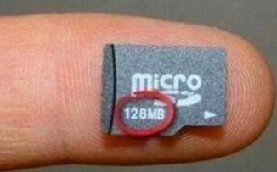
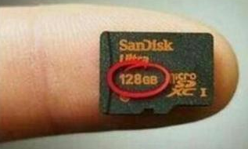
Motivation
10 years between

Slide 7
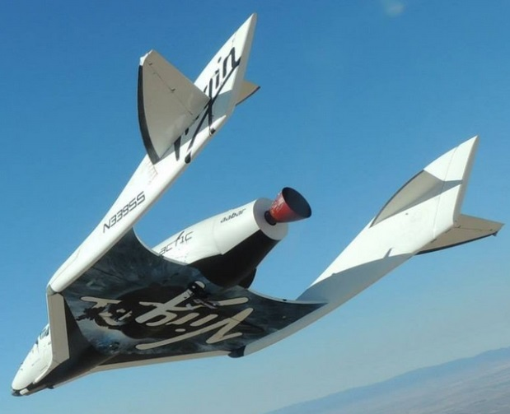
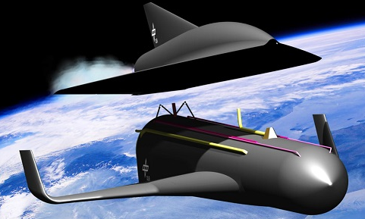
Motivation
Now
Future (Who knows when ?)

Slide 8
Motivation
SWIM
= System Wide Information Management

Slide 9
Motivation
SWIM "Intranet for ATM" concept requests all the future air traffic participants acting as communicating sub-systems.

Slide 10
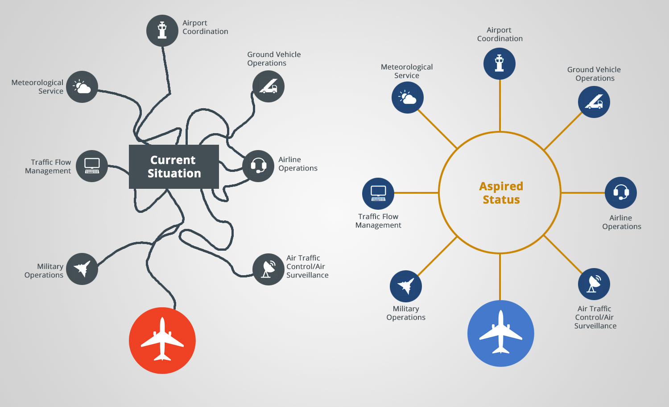
Motivation
SWIM → Why ?
Source: https://www.einfochips.com/blog/k2-categories/aerospace/iot-in-aviation-with-system-wide-information-management.html

Slide 11
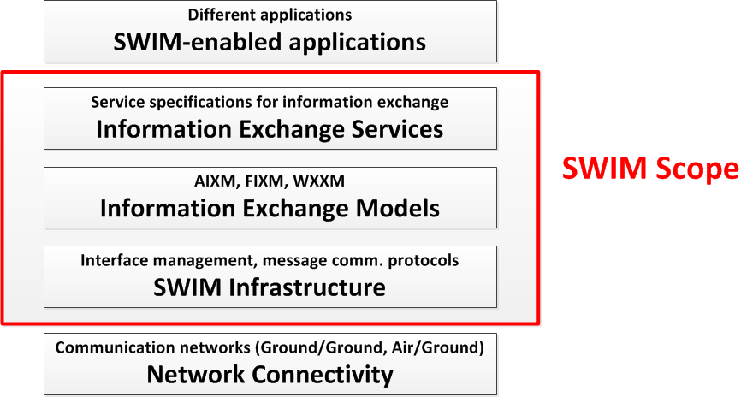
Motivation
SWIM → What ?

Slide 12
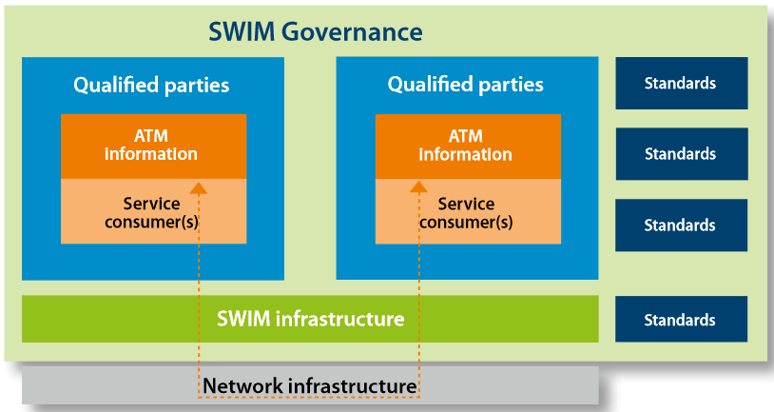
Motivation
SWIM → What ?
Source: http://www.sesarju.eu/sites/default/files/documents/wac/SWIM_Becoming_a_reality_Brochure.pdf

Slide 13
Motivation
SWIM → What ?
Technical profiles:
  Yellow → non critical information
  Blue→ critical information
  Purple→ Air / Ground info exchanges

Slide 14
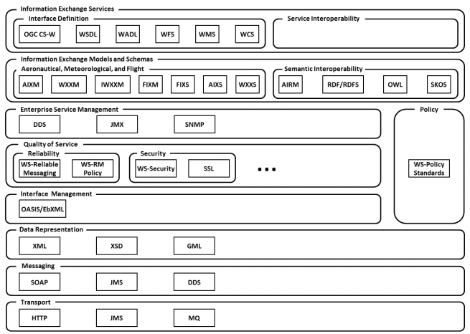
Motivation
SWIM → What ?
Source: Manual on System Wide Information Management (SWIM) Concept, ICAO Doc 10039 AN/511

Slide 15
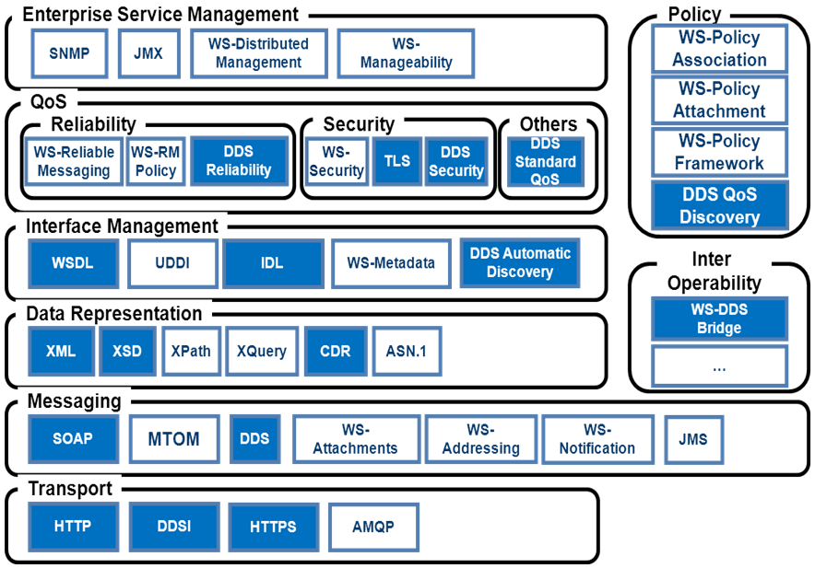
Motivation
SWIM → What ?

Slide 16
Motivation
Benefits of acting SWIM compliant
Access to real-time, relevant aeronautical, flight, and weather information → faster dedicated response possibilities
Reduced implementation, operating and extension costs because of SWIM’s standardized character
SWIM = requested fundament of the future for info based collaboration in ATM (Air Traffic Management) → being prepared for the future

Slide 17
Challenge
Safe global space traffic integration by taking into account data distribution of its changing debris (= hazard) area during reentry !

Slide 18
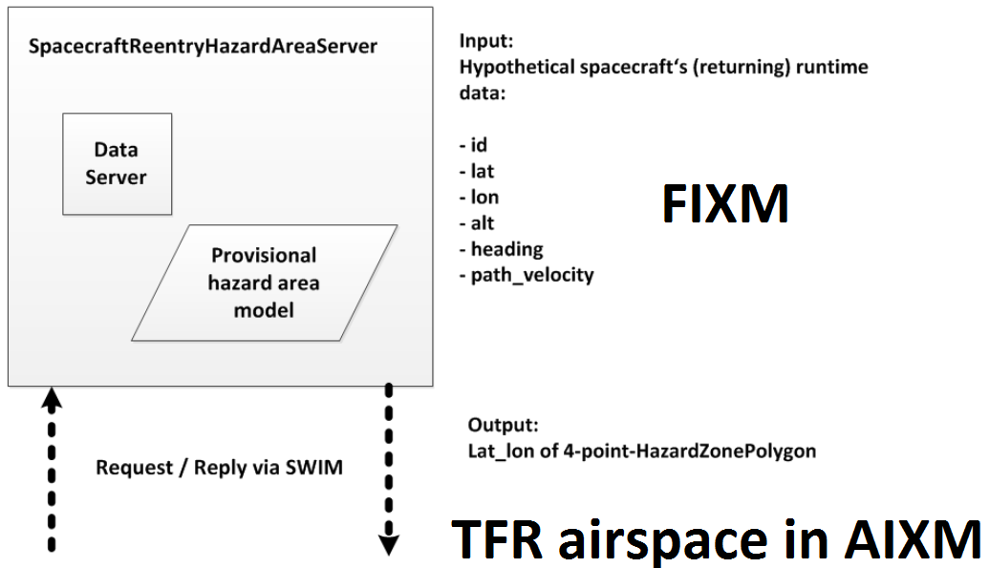
Solution

Slide 19
Solution using:
TclHttpd as the web server
Web Services for Tcl for the server side web service creation on top of TclHttpd
TclTLS for using HTTPS
Rpcvar for complex data type definitions
CriTcl for improved performance by the usage of C code runtime embedding
BaseXClient-Tcl for using the BaseX server protocol to communicate with the hazard area model database server

Slide 20
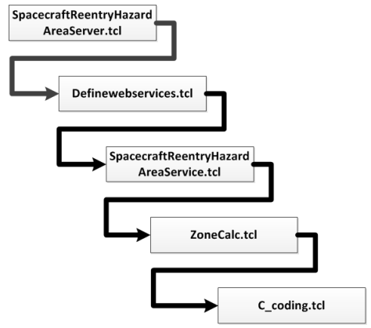
Solution structure:

Slide 21
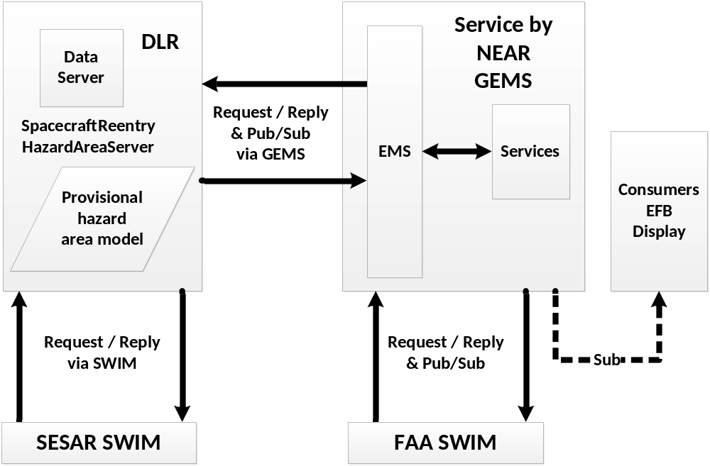
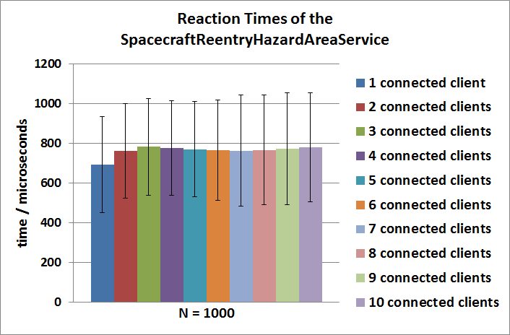
Solution

Slide 22
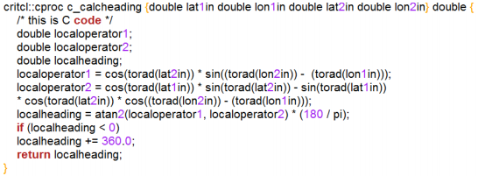
Solution CriTcl usage (excerpt):

Slide 23
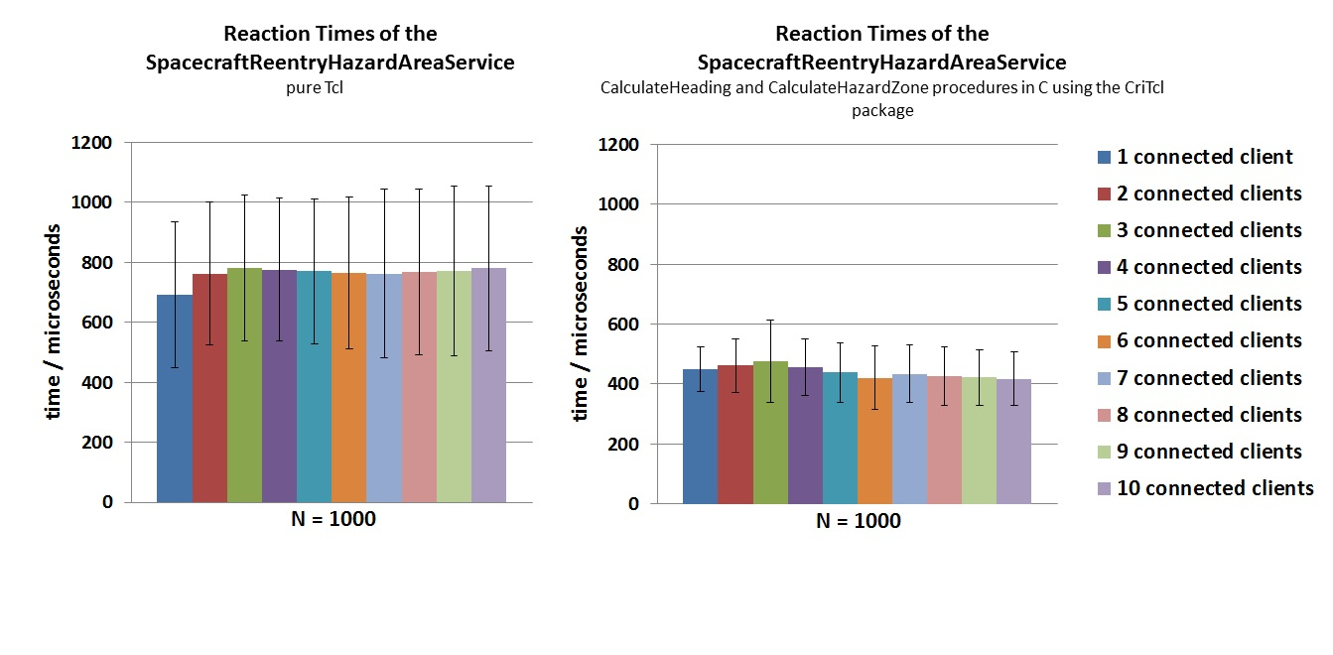
Solution (performance enhancement)

Slide 24
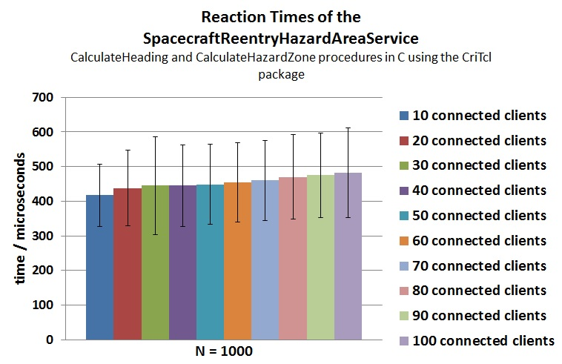
Solution (scalability)
Sufficient for
most small and
medium sized
cases !
Anyhow ….

Slide 25
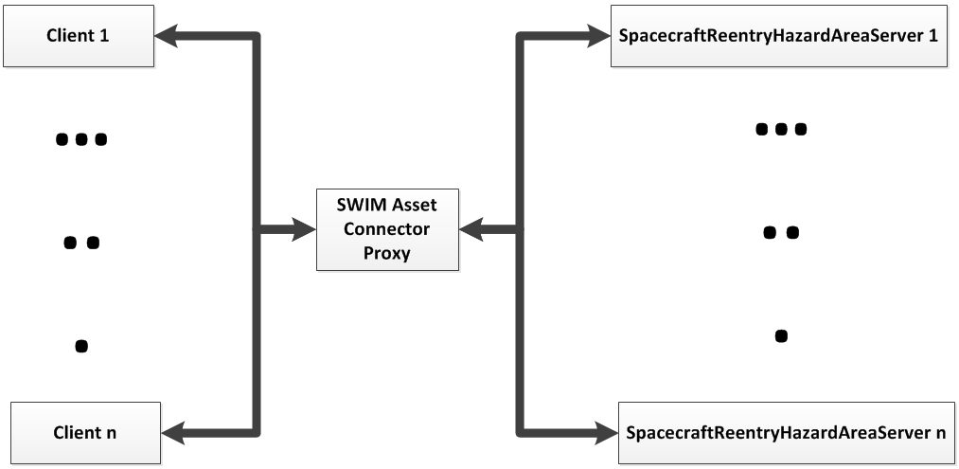
Solution (scalability)
Anyhow ….

Slide 26
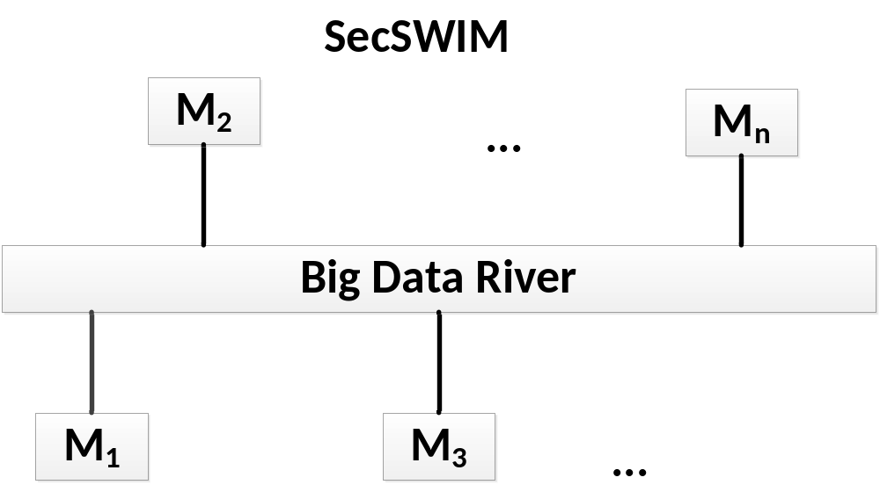
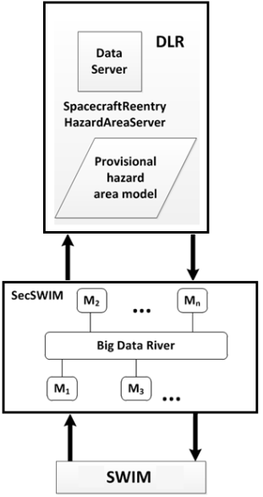
Outlook

Slide 27
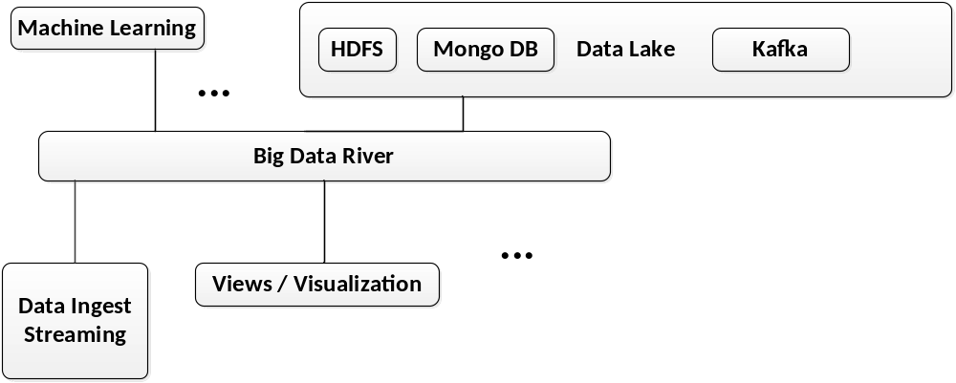
Outlook

Slide 28
Outlook
SecSWIM → foreseen to be developed in ?
→Make an educated guess… ☺
Kafkatcl
TensorFlow (C++ API used inside Critcl)

