Slide 1

TSL Language
Aos Engine Family
SqLite TSL Integration
Year-2
David Simmons, Smallscript Corp
Tcl 2017 Conference

Slide 2


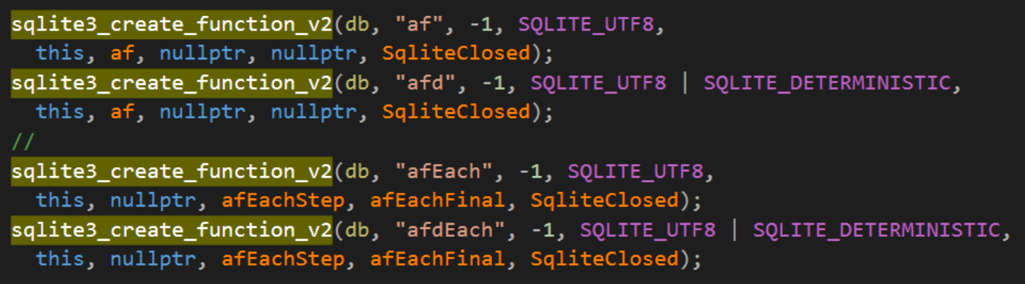

SqLite: SqLite APIs for Cmd Extensions
SqLite Track
“af” procedures
  af: normal
  afd: deterministic
  afEach: normal tables
  afEach: deterministic tables
Deterministic means
  cacheable idempotent
SqLite Api Integration
  build flags
  a few other APIs used as hooks

Slide 3
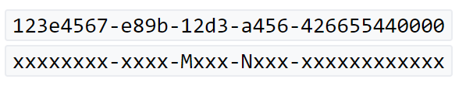
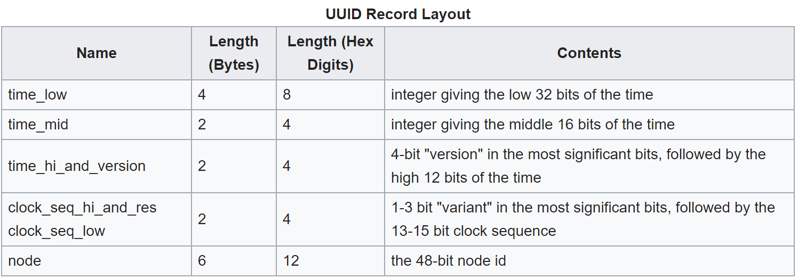
SqLite: UUID - Universally unique identifier
SqLite Track
UUID

Slide 4
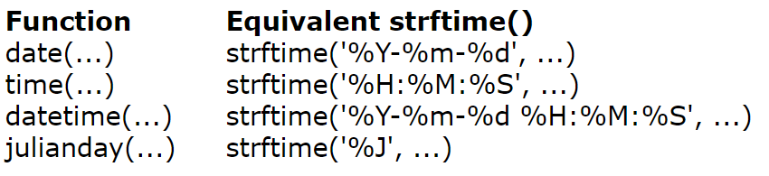
SqLite: Time conversions
SqLite Track
Time Conversion
  %J: Julian days as float
  The julianday() function returns the Julian day - the number of days since noon in Greenwich on November 24, 4714 B.C. (Proleptic Gregorian calendar).
time-fmt: tsl-command
  custom time parsing and formatting library
  parses most text forms
  parses numbers as either epoch seconds in epoch, uuid or FileTime, time 10⁻⁷ 64-bit time
time-fmt({now +1 day -2 hours
-7 min, {%J});
time-fmt(connection.time-created,
{%Y/%m/%d %H:%M:%S.%f UTC});
time-fmt(uuid-create-sequential(),
{%Y/%m/%d %H:%M:%S.%f UTC});

Slide 5
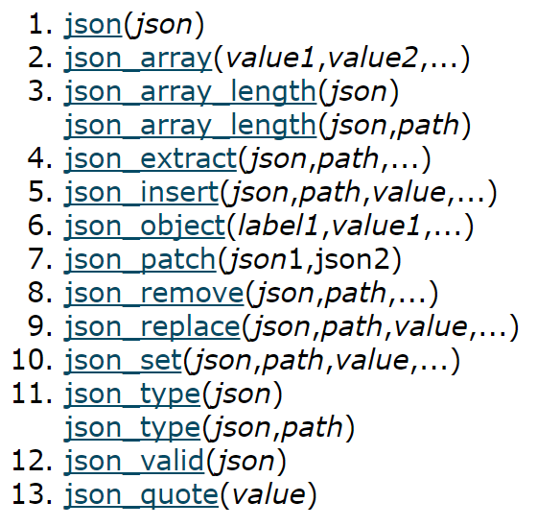
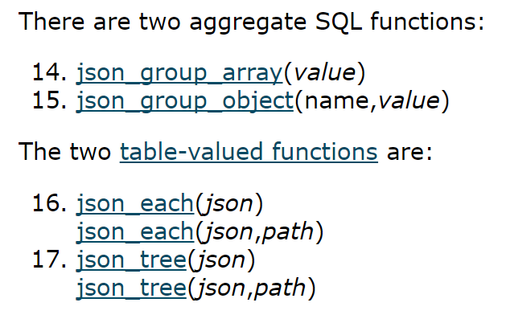
SqLite: JSON Interchange & Ad-Hoc Records
SqLite Track
JSON1 Library
  Json data in records
    jFieldName
  Json as tables in sql expressions
CRUD triggers on columns and indexes
JSON1 (flaws)
  Empty and Nullable
  Caching

Slide 6
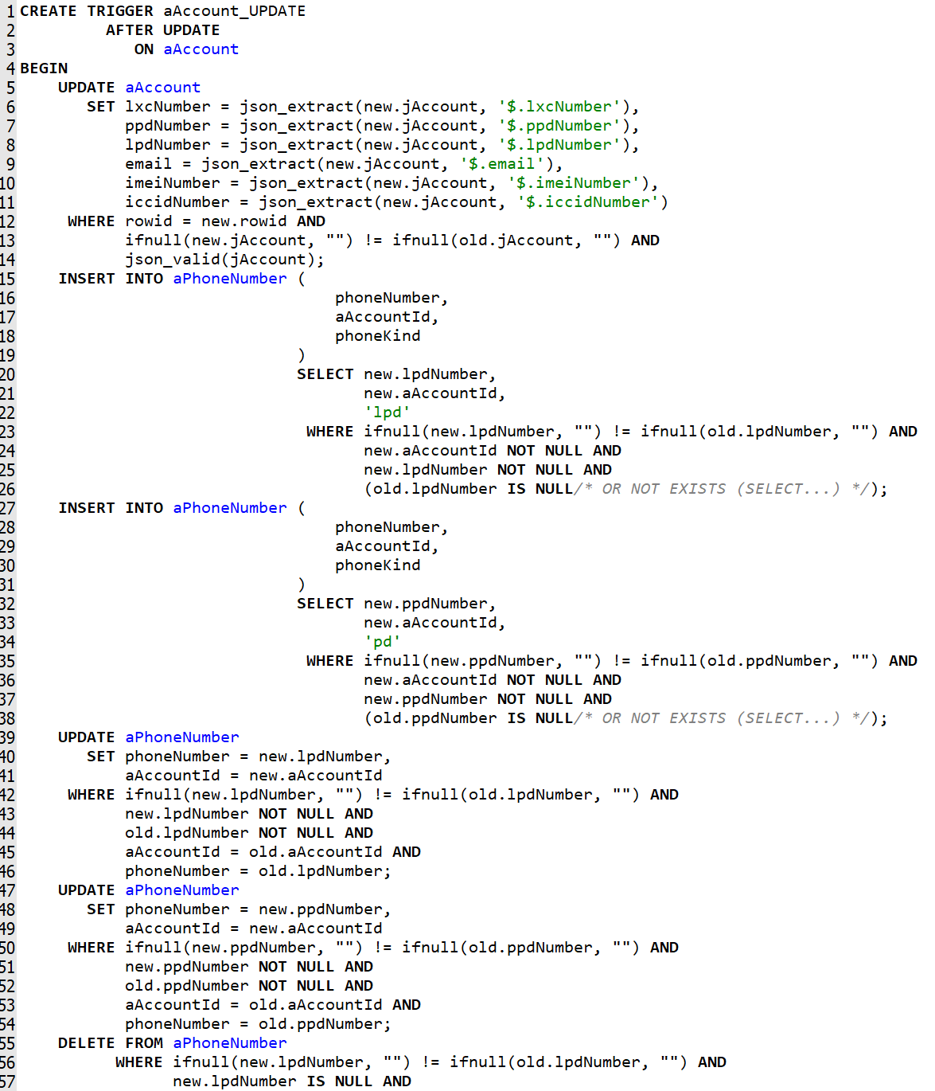
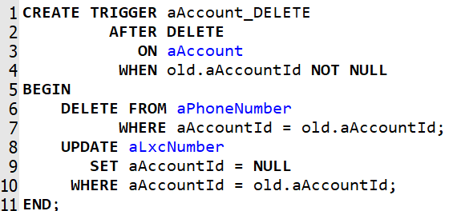
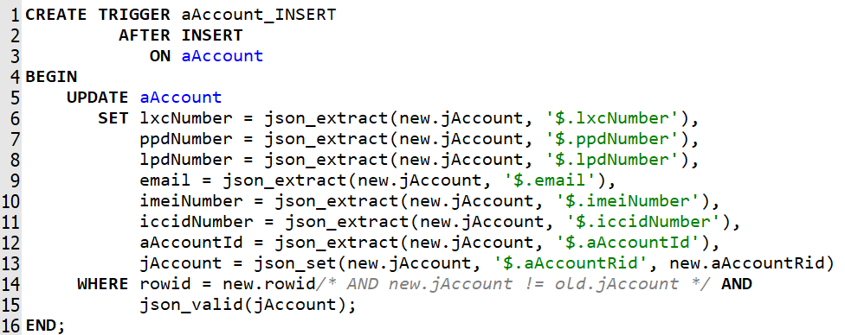
SqLite: sql triggers
SqLite Track

Slide 7
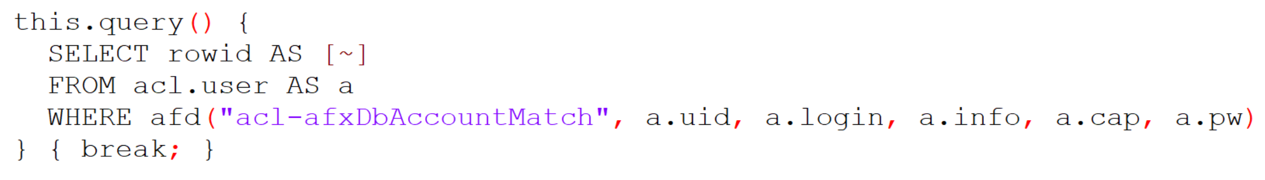
SqLite: sql query using .af command
SqLite Track

Slide 8
DEMO

Slide 9
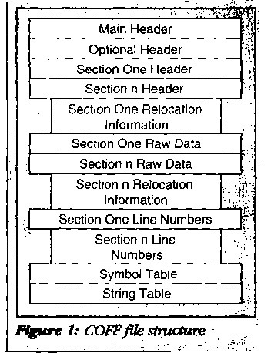
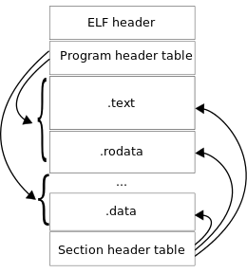
SqLite: Integrating TSL
SqLite Track
sqlite “lib”
  built w/JSON1
    convinced a number of the poplar open source tools to add JSON1 to their nightlies
afm built as a single “lib”
  built from a single “cpp” file
  Linked as “afm.exe” console subsystem coffbox
    Renaming “afm.exe” a .SO or .DLL
    Exporting standard DLL API interfaces
AOS/S# COFF binary ffi-thunk bBuilder

Slide 10
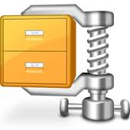



SqLite: Packages “DBs as vfs Pkg”
SqLite Track
SqLite Header
  SiteId, AppId
Common DB extension forms
  .afx, .afr, .dpk, .zdb [FsPath VFS model]

Slide 11
SqLite: Schema concepts - sqlite_master
SqLite Track
sqlite_master
  VersionSchema table concepts
    VersionSchemaTrigger table
db-resident scripts
  StoredProcedures
    Where to place stored procedure code depends whether a vfs-repo-fs table model is available
Undefined sql API hook (NFH)
  Allows lazy NFH lookup into existing environment, or lazy load from db stored procedure tables

Slide 12
End of Slides

Slide 13
TSL Language
Aos Engine Family
Devops and the CoffBox Model
Year-2
David Simmons, Smallscript Corp
Tcl 2017 Conference

Slide 14


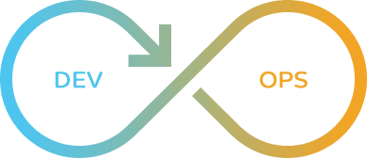
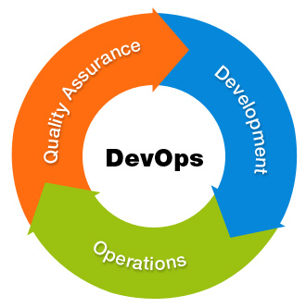
CoffBox: DevOps Concepts
Deployment Track
Executable Components
  afm.exe
  afm-symlinked-name.exe
  executable-db-vfs-pkg.afx
    usually a “.afr” that’s been symlinked
    shebang-#!path or pathext-ext registered.
  script-name.afts
Registering script types
  Windows
    PATHEXT
    ftype, assoc
    registry twiddling for overloading
  nix*
    shebang - #!path header
    chmod

Slide 15
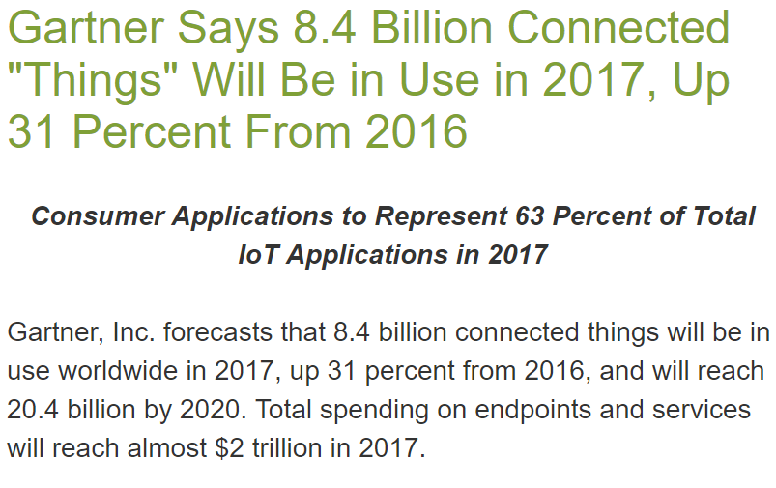
CoffBox: Private Cloud
Deployment Track
My home office environment
(by way of example)
  Networks
    10GB Fiber
    Mesh WiFi
    ZWave, Ethernet-over-power
  over
    70TB NAS storage
    20 computers
    200 devices
  OS
    Linux
    OSX
    Windows
    Others

Slide 16
CoffBox: Explore Desktop
Deployment Track
Show Files and Locations
Demo App

Slide 17
CoffBox: DevOps Concepts
Deployment Track
.af directory patterns
  .conf customization model
    search paths
SymLinks
  client system relative
    symlinks, reparse-points
  host system relative
    junctions
  absolute and relative paths
  repo-treatment
    ignored, as-file
    xattr archive-flag
Virtual Drives
  .dmg, .vhdx, linux sparse file images
Packaging Model
  .af directory pattern
  .afws
  .afr, .afx
  .afts scripts

Slide 18
CoffBox: Build a script
Deployment Track
script w/command line arg processing

Slide 19
Build an afx w/.conf checked into it. Showcase demo webserver

Slide 20
CoffBox: DevOps Concepts
Deployment Track
Customizing a System
Reflecting on a System
ChildProcess
  pipes
    http(s), message-queues
  sockets
    http(s)
EventLog mechanisms
  telemetry reporting
::system::info
  elevated, admin, etc
reg- commands

Slide 21
CoffBox: DevOps Concepts
Deployment Track
Binary build model
  cpp, hxx, hpp, h
Single Binary for Exec & DLL (.so)
  Coff Format
  Subsystems
  Sections
    Resources
    Read-only Memory Repos
TSL scripts exported as native COFF library binaries (.so, .dll, .exe)
  your-code-thunk.dll - thunk-bridges

Slide 22
End of Slides

Slide 23
TSL Language
Aos Engine Family afm
Year-2
David Simmons, Smallscript Corp
Tcl 2017 Conference

Slide 24




iOT: Purpose Built Constrained Environments
iOT Track
Constraints
Typical metrics
Maybe single app
Security
Storage types
Hw permission and firmware controls
Memory
Power Management Lifecycle
  CPU Cycle Cost
RTOS Constraints and Models
  Embedded toolset contraints
Memory
Cpu
Storage
Power Management
Os Services

Slide 25
iOT: engine requirements for iOT deployment
iOT Track
Os Platforms
  Windows, OSX, iOS, Android, Linux, Linux Embedded, FreeRTOS, nuttx, nucleus rtos
see https://www.osrtos.com/
Cpu Targets
  Arm (32, 64), Intel x86/x64, MIPs

Slide 26
iOT: Device Use Case
iOT Track
Networking
  Wifi, Bluetooth, Wired-Ethernet, ZWave, Zigbee
Web Server/Service
  Telemetry
  Updates
  Device Interop (peer, slave, master)
UX
  custom displays
  custom input/sensors
VFS
  Packaging, Versioning
  Resources, executable components
Power Management Lifecycle
  Device On/Off
Device Firmware Update Models
  Rollback, Upgrade
  Build, Package, Sign requirements
  Flashing Lifecycle Constraints
    OTA, Wired

Slide 27
iOT: Afm’s iOT ready architecture
iOT Track
Coff binary build model
  cpp, hxx, hpp, h
  embedded r/o “.afr”
    compression
Codecs
  compression
Engine Design
  Booting Model
  Thread Model
    engine-affinity, fiber-co-operative, rpc message streams
      pipes, tcp, ssl, http
      json, html, …
Pal: Host Abstraction
  Memory – cpu/kernel direct
    TLS – CPU direct (mirror OS model)
  Interrupts, Signals, Exception
  Debugger Aware Channels
Pal: Cpu Abstraction
  FPU, Vector
  MP-Sync Instructions
  Bit Operations
  Special Forms
Pal: FsPath Pluggable Abstraction
  Native File System, (tags, versioning) Fs built on SqLite blobs, Registry, Fuse/Dokan, HTTP(S), BuiltIns
Communications
  Transports
    Ethernet, Bluetooth, Serial
  Sockets
  DNS, DHCP, HTTP (1.0, 1.1, 2.0 ALPN)
  SSL, Certs (pal and host integrated)

Slide 28
End of Slides

Slide 29
TSL Language
Aos Engine Family
Language Concepts and Usage
Year-2
David Simmons, Smallscript Corp
Tcl 2017 Conference

Slide 30
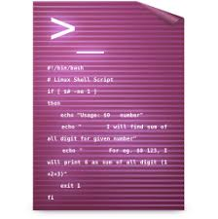


Statements: JS & TCL 12 Rules Disambiguation
Language Track

Slide 31
Engine: Model
Language Track
Procs and Threads
Code Locations
Process Model
  multiple engines allowed per process
Engines
  engines have thread affinity
  co-operative threading within an engine
Namespaces
  ::super
  ::system
    ::afm
  ::shell
  ::app
    ::script
FsPath Concepts
  SymLinks
    Archive XAttr-Flag
Process Loading Model
Script Binding Model
Web Site and Page Model

Slide 32
Statements: Statement Tokenization and Substitution
Language Track
Phase 0: Text Command Statement
  Statement Delimiting
    else rules [command must defer-level1]
    ; eos
    {} eos
    # eos
    ‘ws’ eos [tcl-mode only]
Phase 1: Command
  Phase 1a: Expr Args
  Phase 1b: semicolon args
Phase 2: Binary Operators
Phase 3: TCL Parameters
Comment Forms
  // EOL
  /* nestable */
  # - special command, NFH form
    Allows #command if NO whitespace
Word Grouping Rules
  () first following command
    allows whitespace
  () {} … no other tokens
    partitions into discrete words whether whitespace or not
Deferral Levels 1,2,3
  =, ? ... :
  for() …
  do while {}
  return

Slide 33
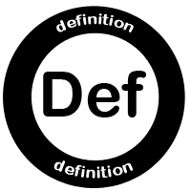

Commands: Forms
Language Track
Types
  proc
    ::super namespace
    protected from re-definition
  func (fn)
    context bound
  method
    this, prototype bound
Mint-Paths
  All commands are namespace types and get minted
Modes
  default
  ^ uplevel & native proc^
  @ modules
Prototypes
Tson Declaration/Merge &:{}
Declaration Features
  parameter binding
    binding (*a, &b, ?z, {x {}})
Invoke named parameters
  ( key: value, )
Observation and NFH
  Loader Hooks, NFH

Slide 34
Eval: Expressions
Language Track
Operators
  new …
  func …
  = (op-assign)
  numeric ops
    .qualifiers for typing
  ==
    ===, ==~, !=, !==, !=~
  Short Circuit Boolean Ops
    ||, &&
Contexts where it is implicit eval
  pathx invokes ()
  pathx indices []
  tcs-line
    text command statement

Slide 35
Path Expressions: Operators
Language Track
PathX
  $$,$?,$!,$:
  &:, &?
  delete &
  && upvar
  (expr), {}, [expr]
“”, {}, [] and tcp
  token/macro rules
PathX Operators (incl reserved)
  . operator
    .*() invoke
    .. cascade
  :: and ! binding operators

Slide 36
Path-Expressions: VarRefs
Language Track
Variable References
& Operator
  Stack-Context References
    &(#)
  &pathx – deferred binding
  [expr] => {scalar-key}
  && Upvar model
Name Partitioning
  …
  this
  super
  @key, key@qualifier
  {literal-key-closing}
    escape rules
Valid Name Patterns

Slide 37
Namespaces:
Language Track
Foundation
Concepts
Namespaces
  ::super
  ::system
    ::afm
  ::shell
  ::app
    ::script
  ::global
    modules
Minting
  namespace command
  mint-name concepts
  minting rules
Where Procs Live
Where System information is
User owned
Names
  CamelCase
  Hyphenated

Slide 38
Commands: Categories - patterns
Language Track
Naming Patterns
  Case Usage
    Uppercase – factory (new)
    Lowercase - variable
  CamelCase - methods
  Hyphenated - functions
  Special commentary
    @names
    this-… names
    super
Locations
  Modules
    ::super proc space
    ::app, ::lib
    reserved
      ::globals – for local composers
      ::afm, ::system, ::shell
      ::app, ::script
Module Naming pattern
  domain – like package model
  uuids – anon modularization

Slide 39
Commands: Categories - groupings
Language Track
file-, dir-, fs-
string-
mint-
sql-
time-
?put*
@*

Slide 40
Commands: include, require, fs-find
Language Track
Key variables
Extensions
::system::path
::app::path
::shell::path
::shell::ext
::shell::jails
-ncf
-aei

Slide 41
End of Slides

Slide 42


What we are going to see this morning..
TSL
Text Scripting Language
AFM
Design and demos
Aos Engine Family
25th Anniversary
Rich Web Servers
DevOps Toolset
Repo VFS CMS
Integrated SqLite
Single Binary
Open Ssl, Certs, Json, Markdown, HTML, TCP, Sockets
CLI, Ansi, EventLog, Services, Pipes, Exec, Codecs
acl-security, file-system, registry, env, time-codec, uuids
1st class Sql support
JSON, Sql Procs
Config Free
SymLinks

Slide 43
TSL Language
Aos Engine Family afm
Year-2
David Simmons, Smallscript Corp
Tcl 2017 Conference

Slide 44

Refresher, demos, discussion
For those I did not meet last year,
my name is David Simmons
A year has gone by…
  This morning we are going to see how TSL/AFM has evolved.
The beginning of this talk will be a refresher
Then we will go into a series of demos and discussions

Slide 45



Thoughts to share…
Over the last year, the afm system has been actively serving 10,000+/engine
PBX cloud telephony users
Single-binary, single db pkg-file
  coff-box symlink model, single db-file package system (vfs)
  drop install on any machine.
Setting up new servers is only a few minute operation
  fail-over, scaling, and versioned upgrades are
  mostly automated by simple remote check-in/out.
Full server and devops set of stabilized features
  More than is possible to cover in a talk.

Slide 46
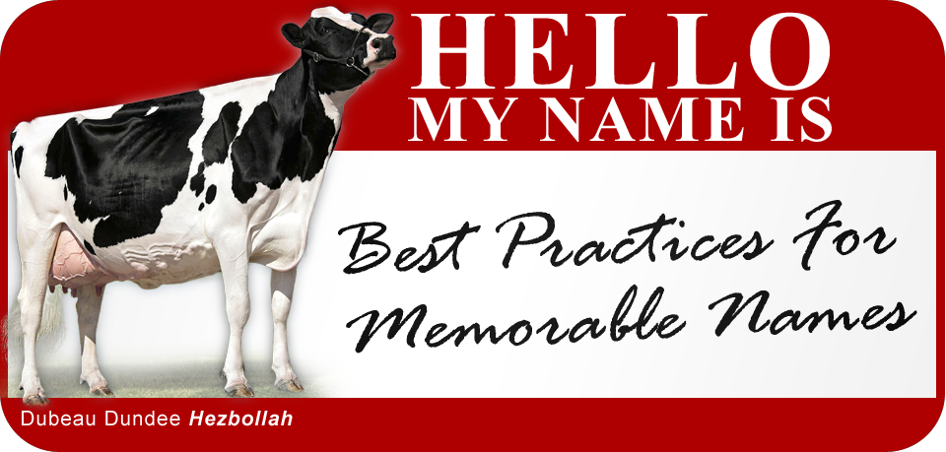
On the subject of Names
What is the acronym “st”?
  Site, Smalltalk, Smallscript
What is the acronym meaning of “AOS®”?
  Agents Object System, Agile Object System, Actor Object System
What is the acronym root “af” of “afm” stand for?
  collates top of the alphabet ☺
  Aos-Family, Aos File Manager, Aos Fossil Manager
But in all seriousness:
  Carefully thought through names and naming conventions are critical to a language design and best practices for code libraries.

Slide 47


My language implementation timeline
1978-1997
1997-2017 (Owner/MSFT Architect)
NBS Net/ArpaNet HW w/Basic (6512)
  Forth, APL, Mix of Shell Languages, many others of the era
Fortran, Lisp, PostScript, …
Message-C, SIAL, Informix SQL’s Full Text engine for International Publishing on BRS/Dialog with TeX
QKS Smalltalk, Prolog, Scheme,…
  MacOS AOS 1991/1992-1998
    Embedded in QuickTime
  Windows 1994-1998
Newton, AppleScript, Kaleida/SK8, Taligent
Smallscript, S# Language
  Native engine, .NET Runtime DLR 2000 PDC
VBA, Visual Basic.NET
JavaScript
.NET Mobile Runtime and XNA
PowerShell
AFM/TSL

Slide 48
20MHz Mac Smalltalk
4GHz 12-core PC
1.5+GHz 4-core Arm
Public Cloud VMs
$8 Cellular Wristwatch
DEMO
1997
Flashback to the good old days
iOT, Edge, Private Clouds
Mesh Networks, 10GB fiber NAS

Slide 49
History: Smalltalk’s failure to be relevant
1986-1996 (gave life to the era of Java)
2007-2017 (Rise of the mobile iOT Device Net)
Awesomely productive and rich toolset capable of talking to almost anything
Immense integrated frameworks
Pioneered many aspects of modern software development from patterns, agile programming, unit testing
Disaster for working with text and file-based code management and practices
Monolithic image system unable to integrate within other systems, execution engine scaling issues
Decompositional Model challenge to schema version, package, and be small and bootstrap from nothing
Everything connected, people message, and watch/create content on their schedule
Compute is cheap $8/full watch cpu competitive with 2004 PC
Embedded, real-time, devices proliferate and with it immense scaling challenges
HTTP, JSON, HTML-UI dominate compute systems
Text processing and file-based assets dominate compute design with massive stack-based libraries
devops challenges and complexity single largest impediment to evolution

Slide 50
Back to the present
2017
Why Text matters
more than ever

Slide 51
FsPath system: virtual versioned file system
Let’s begin by talking about the FsPath system
  pluggable and defaults to supporting:
    Disk
      fully symlink, xattr and stream aware
    Versioned repo (scm)
      System core files baked into the afm coff binary as a r/o repo
    Web based files
  has a specific path syntax for disambiguating content
    server-type
      file-system (default, current directory)
        streams/xattr support
      repo vfs
        branches, tags, versions support
      af web-server generalized
Fuse
Dokan
Registry

Slide 52





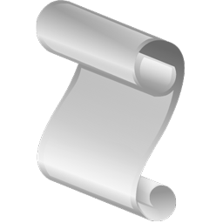
include command: .tsl; .afts; .md; …
include
require
fs-find
/~:alias/path/file.ext
path aliases are located in ::app::path ^ ::system::path maps
①
②
File folders
on disk
Branch folders
in local repo
(versioned)
Branch folders
in r/o coff repo
Branch folders
in https repo
(versioned)
/path/file.ext
N:/path/file.ext
N:/path/dir:xattr-stream.ext
/:branch:repo/file.ext
.afr;
.afx;
.afws
~:/path/file.ext
afm.exe
afx.exe
afts.exe
https://af.st/:branch:repo/
./.af/site/
./.af/sites/domain

Slide 53
End of Slides

Slide 54

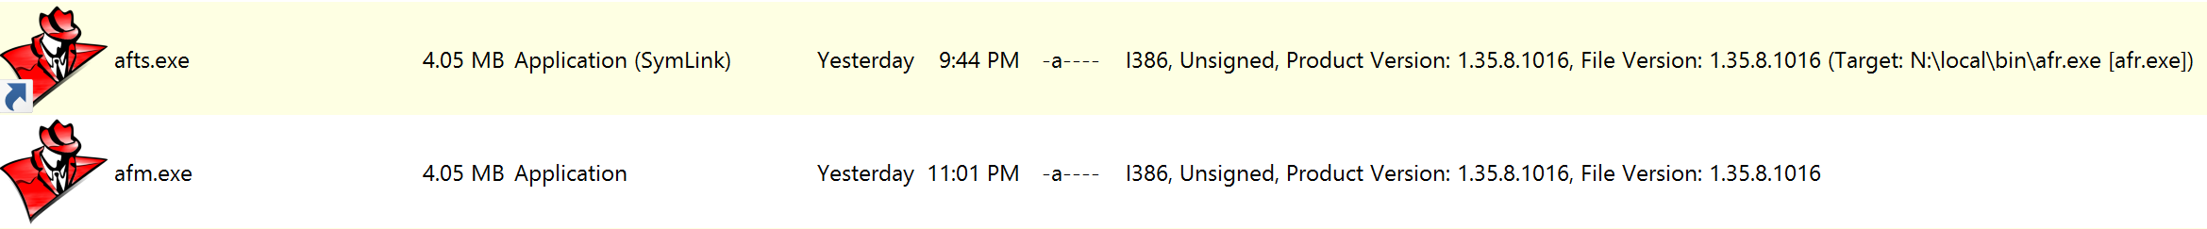
AFM executable
Self-installing single host executable that uses symbolic-link file-naming to determine its execution behavior
The executable’s File Name is used by kernel.tsl code to determine the execution path as it examines the exec command line; this allows efficient creation of single shared binary tools using symbolic-link naming patterns.
Fossil-SCM
kernel.tsl
Rich Web CMS
②
①
.afx
.afr
Repo db(s)
Afx Web Servers
time-fmt, csv/cst, child-process, certs/ssl, sql-procs, many-codecs, regex, debug-io/events, registry/env
SqLite
TSL Language 1.2
Open Ssl
COFF (binary bundled) Executable
afts
Intel, ARM, …
*nix, ms-windows
afm

Slide 55
Variable Path Expressions
JSON Expressions and TCL quirks mode support
…
$ & :: identifier . (…)
&& ^ {…} ::
. […]
Examples:
$![putl "Hello"]¹ $!{string "Hello"} † $!(17 + 5 % 3)³
$::identifier-expr $^identifier-expr $identifier-expr
$identifier.{literal-key}.[expr-key] $a.b[3] $a::b[3] $a.b::[3] $a{b}[3]["z"]
$receiver-path-expr::namespace-expr(?invoke-expr-param?, …)
Cases of Note:
&:{ … JSON pojo … } JSON pojo supporting TSL eval expr extensions and auto-conversion.
&:[ … JSON poja … ] JSON poja supporting TSL eval expr extensions.
var identifier-path = &&var-ref-path; Binds two variables, as opposed to assignment.

Slide 56
Startup sequence: she`bang-script binding
shebang #! /local/bin/afts
ms-pathext ftype.exe && assoc.exe registry mapping
Process Exec
main
primary thread
Engine Init
TSL Core Registered
.af/.conf.tsl
conf located and run
Link-name executed as command, if available
Not-found Hook Invoked to load command
script relative .af/
exe relative .af/
coff system pmsp .af/
②
①
afm
Fall-through to fossil-default
Command Executed as Program
OR

Slide 57
Command re-examined as Message
statement
word-tokens: literal, macro-forms
$ "…" […] {…}
Command
Params (aka words)
cputl $msg; # A TCL command with macro-param
cputl(msg) # A TSL function with expr-param
this.cputl(msg); # A TSL method with an expr-param
this.cputl() $msg; # A TSL method with a macro-param

Slide 58
TSL Language
Aos Engine Family afm
David Simmons, Smallscript Corp
Tcl/Tk 2016 Conference

Slide 59
What we are going to briefly tour this afternoon..
TSL
Text Scripting Language
AFM
Its COFF binary executable host
Aos Engine Family

Slide 60
DEMO
afts
Command Line Script

Slide 61
TSL
DSL:
Domain Specific Language
As a language TSL is founded on the macro and command patterns used in TCL
As C++ can be described in relation to C,
TSL can be described in relation to TCL
It would be incorrect to describe TSL as a dialect of TCL
TCL
Macro & Command Patterns
JavaScript blended syntax & intrinsic JSON
Smalltalk, Lisp, Self messaging behavior
and
Intrinsic C++
object integration
Executable Libraries: Source, Op-Codes, and precompiled Machine Code
Frameworks, IDE, Image-Snapshots, Intrinsic-Repos
Object Model:
prototype, mixins
Path Binding Engine:
predicate binder
Execution Invocation: Interp-JIT, FFI
Host Integration
& Lifecycle Model
AOS Execution Engine and Container System
Perspective Types:
Versioning, Modularization, Security
Dynamic Composition
Aspect-weaving and introspection

Slide 62
AFM executable
Self-installing single host executable that uses symbolic-link file-naming to determine its execution behavior
The executable’s File Name is used by afconfig code to determine the execution path as it examines the exec command line; this allows efficient creation of single shared binary tools using symbolic-link naming patterns.
aflib
Fossil-SCM
afconfig.tsl
②
①
.afr
Repo db(s)
TSL Language
C/C++ implementation
Files and Directories
BuiltIn FileSystem
SqLite
AOS Execution Engine
System and Libraries
Intrinsic Resources
C/C++ Libraries and Services
COFF (binary bundled) Executable
afts
Intel, ARM, …
*nix, ms-windows
afm

Slide 63
Brief Intro, then on to demos and tour
Hello, my name is David Simmons
For 25 years I’ve had a particular specialization in high-performance hybrid dynamic-static language runtime systems.
By education, I am an Electrical Engineer and Astrophysist specialized in VLSI design. However, most of my career has been as a Software Engineer and Architect
  Working on Operating Systems, Hardware Devices, Real Time Systems and Programming Languages and their Execution Machinery and Infrastructure
    I began my career some 40 years ago, in the summer of 1976 at The National Bureau of Standards which is known today as NIST (The National Institute of Science and Technology) working on Fortran Runtime Real Time Libraries, Perkin Elmer Operating System Development, and ArpaNet NBS Net Packet Switch Hardware and Analyzers.
Employed working with or for:
  NBS/NIST, U.S. Congress, Air Force, Faculty at UofMd NSF Systems Research Center, Tokyo Gas, Apple, Suse Linux, Microsoft and worked for or owned a number of small to mid-size companies of up to 250 employees.
Worked on, collaborated on or was lead architect on the following language systems:
  Apple’s Kaleida, Apple’s AppleScript, Apple’s Quicktime-Track-Scripting, Script on Newtons
  Basic, Forth, Message-C, SIAL (1990 ODBC equivalent with full-text search engine), Smalltalk and Prolog, S#
  Microsoft Visual Basic, Javascript/JScript, .NET Runtime (desktop, mobile), XNA, Powershell

Slide 64
Startup sequence
Script binding:
shebang #! /local/bin/afts
ms-pathext ftype.exe && assoc.exe registry mapping
Process Exec
main
primary thread
Engine Init
TSL Core Registered
afconfig.tsl
config located and run
Link-name executed as command, if available
Not-found Hook Invoked to load command
current directory
~/ user‘s home directory
ee‘s home directory
coff-builtin directory
②
①
afm
Fall-through to fossil-default
Command Executed as Program
OR

Slide 65
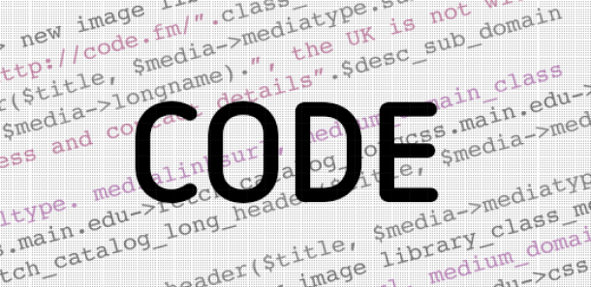
Language
Statements, Expressions and other Concepts
TCL
TSL
Statement
  Composed of Words
    First Word is Command
    Rest is Command Macro Params
Expressions
Things
  Scalars
  Key-Value Containers
Statement
  Composed of First Word and Rest
  First Word is Message
    Command, Function or Method
  Rest is Message DSL Params
    Literal, Macro, Eval
Things
  Scalars
  Mixin Prototype Dynamic Objects

Slide 66
Operators and Keywords
Syntax, Semantics and DSL patterns
Operator Language Type Patterns
{…} tcl Literal text patterns.
"…" '…' `…` tcl+ Macro prefix-names. $(…), $[…], ${…} forms. (…) invocation. Quirks for "[…]".
[…] tcl† Command proc, func, method patterns. Unary and binary symbol method patterns.
(…) tsl Expr (eval) implicit eval pattern.
--
$ tcl+ MX path Operator macro-expand operator for variables and other tokens.
& tsl Ref path Operator reference operator for variables and path expressions.
--
\ tcl+ Escape Operator enables UTF8, ascii and inline-operator escapes.
; tcl † End-of-statement TCL quirks mode for newline and curly-brace EOS.
, tsl End-of-expression Expr eval param delimiter.
--
# /* */ // tcl+ † Comments JavaScript/C++ compatible comments. Quirks for TCL #.
Keywords Description
super this † tsl inheritance operator and contextual variable for accessing inheritance and behavior properties. Within command declaration: this, …, args, *, &, ^.
@ tsl identifier character whose usage rules are restricted to rules defined by the language system.

Slide 67
Command re-examined as Message
statement
word-tokens: literal, macro-forms
$ "…" […] {…}
Command
Params (aka words)
putl $msg; # A TCL command with macro-param
putl(msg) # A TSL function with expr-param
stream.putl(msg); # A TSL method with an expr-param
stream.putl() $msg; # A TSL method with a macro-param

Slide 68
Variables re-examined
Declaration
set varName valueParamWord; # TCL assignment form
set varName; # TCL get command
var varRef = eval-expr; # TSL assignment form
var varRef; # TSL decl command form
Variable Reference is a path
Path roots are:
Global, or in Stack Frame Context down-level of global-root-frame.

Slide 69
Variable Path Expressions
JSON Expressions and TCL quirks mode support
…
$ & :: identifier . (…)
&& ^ {…} ::
. […]
Examples:
$[putl "Hello"]¹ ${putl "Hello"} † $(17 + 5 % 3)³
$::identifier-expr $^identifier-expr $identifier-expr
$identifier.{literal-key}.[expr-key] $a.b[3] $a::b[3] $a.b::[3] $a{b}[3]["z"]
$receiver-path-expr::namespace-expr(?invoke-expr-param?, …)
Cases of Note:
&{ … JSON pojo … } JSON pojo supporting TSL eval expr extensions and auto-conversion.
&[ … JSON poja … ] JSON poja supporting TSL eval expr extensions.
var identifier-path = &&var-ref-path; Binds two variables, as opposed to assignment.

Slide 70
DEMO
var sharing
Script Example

Slide 71
Object Model
Object
Logically, objects reference other objects using key-value associations which can be shared. An association can also be called a variable.
Header
C/C++ Structured Storage
Slots
TSL variables and commands play a key role in how
perspective types are used for versioning and dynamic security
In practice, the internals are more highly optimized and only used associations as an object proxy indirection when sharing requires it.
Variable (aka Association)
ObjRef’s are tagged pointers. Certain scalar values, like IntPs objects, actually have their value encoded directly in the pointer.
Key
Symbol
Value
ObjRef
Expando Type
proto-super
mixin behavior
Object
Object
Header
C/C++ Structured Storage
Slots
Header
C/C++ Structured Storage
Slots

Slide 72
Object Space
One per engine created within a process.
There can be an unlimited number of engines within a process. Each engine takes microseconds to create or release.
The variable predicate path-binder plays a key-role in mixin and path resolution
Global Root
::system
::system::info
Stack Frame
By default, proc declarations are placed here.
#1
thisFrame
::system::commands
Stack Frame
#2
thisFrame
Stack Frame
While crucial concepts, as we will see next, the DSL for intrinsic command declaration constructor forms mean that upvar and uplevel are rarely needed.
thisFrame
#3
By default, func declarations are placed here.

Slide 73
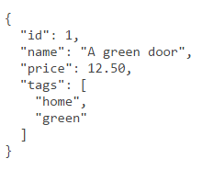
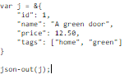

JSON
Given a uniform internal object model, all objects can be converted to or from JSON via serialization.
The original technology name for this in AOS 1992 was PIPOs. Platform Independent Portable Objects, which contained TOCs, DBs, versioning, schema-migration features and supported cross-machine migration of threads and UX components with automatic re-wiring.
When TSL networking protocols for HTTP/HTTPS with JSON are combined with SQL TRIGGERS in SqLite using JSON1, powerful robust systems can be easily built.
Object
Object

Slide 74
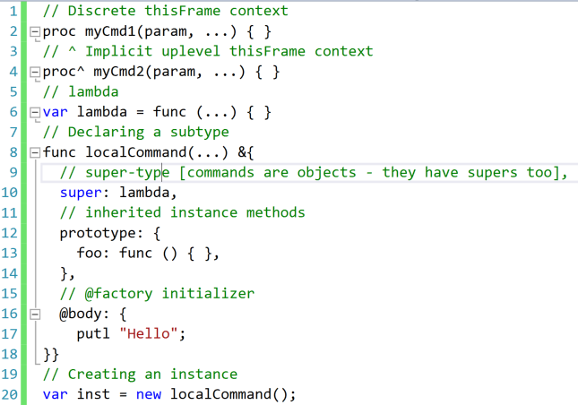
Commands are objects
Scripts are lambda commands
Modules are commands with additional metadata.
Source has provenance, which plays a role in perspective-type binding of versions and access security.
Since objects are pathable and commands are global or contextual objects, commands are commonly used as namespaces.

Slide 75
QUESTIONS
More demos
offline and BOF

