Slide 1

TSL Language
Aos Engine Family afm
David Simmons, Smallscript Corp
Tcl/Tk 2016 Conference

Slide 2

What we are going to briefly tour this afternoon..
TSL
Text Scripting Language
AFM
Its COFF binary executable host
Aos Engine Family

Slide 3
Brief Intro, then on to demos and tour
Hello, my name is David Simmons
For 25 years I’ve had a particular specialization in high-performance hybrid dynamic-static language runtime systems.
By education, I am an Electrical Engineer and Astrophysist specialized in VLSI design. However, most of my career has been as a Software Engineer and Architect
  Working on Operating Systems, Hardware Devices, Real Time Systems and Programming Languages and their Execution Machinery and Infrastructure
    I began my career some 40 years ago, in the summer of 1976 at The National Bureau of Standards which is known today as NIST (The National Institute of Science and Technology) working on Fortran Runtime Real Time Libraries, Perkin Elmer Operating System Development, and ArpaNet NBS Net Packet Switch Hardware and Analyzers.
Employed working with or for:
  NBS/NIST, U.S. Congress, Air Force, Faculty at UofMd NSF Systems Research Center, Tokyo Gas, Apple, Suse Linux, Microsoft and worked for or owned a number of small to mid-size companies of up to 250 employees.
Worked on, collaborated on or was lead architect on the following language systems:
  Apple’s Kaleida, Apple’s AppleScript, Apple’s Quicktime-Track-Scripting, Script on Newtons
  Basic, Forth, Message-C, SIAL (1990 ODBC equivalent with full-text search engine), Smalltalk and Prolog, S#
  Microsoft Visual Basic, Javascript/JScript, .NET Runtime (desktop, mobile), XNA, Powershell

Slide 4
DEMO
afts
Command Line Script

Slide 5

TSL
DSL:
Domain Specific Language
As a language TSL is founded on the macro and command patterns used in TCL
As C++ can be described in relation to C,
TSL can be described in relation to TCL
It would be incorrect to describe TSL as a dialect of TCL
TCL
Macro & Command Patterns
JavaScript blended syntax & intrinsic JSON
Smalltalk, Lisp, Self messaging behavior
and
Intrinsic C++
object integration
Executable Libraries: Source, Op-Codes, and precompiled Machine Code
Frameworks, IDE, Image-Snapshots, Intrinsic-Repos
Object Model:
prototype, mixins
Path Binding Engine:
predicate binder
Execution Invocation: Interp-JIT, FFI
Host Integration
& Lifecycle Model
AOS Execution Engine and Container System
Perspective Types:
Versioning, Modularization, Security
Dynamic Composition
Aspect-weaving and introspection

Slide 6
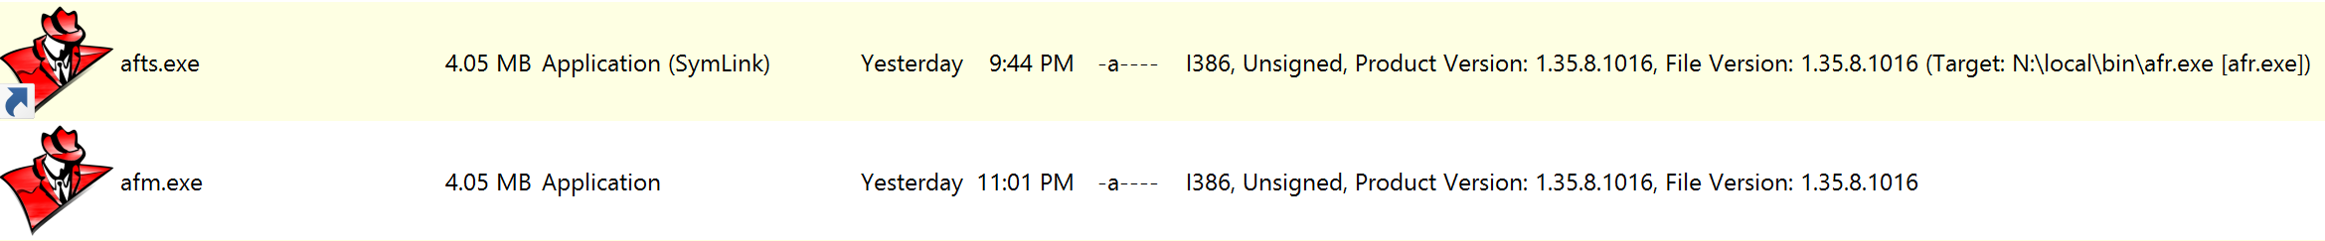
AFM executable
Self-installing single host executable that uses symbolic-link file-naming to determine its execution behavior
The executable’s File Name is used by afconfig code to determine the execution path as it examines the exec command line; this allows efficient creation of single shared binary tools using symbolic-link naming patterns.
aflib
Fossil-SCM
afconfig.tsl
②
①
.afr
Repo db(s)
TSL Language
C/C++ implementation
Files and Directories
BuiltIn FileSystem
SqLite
AOS Execution Engine
System and Libraries
Intrinsic Resources
C/C++ Libraries and Services
COFF (binary bundled) Executable
afts
Intel, ARM, …
*nix, ms-windows
afm

Slide 7
Startup sequence
Script binding:
shebang #! /local/bin/afts
ms-pathext ftype.exe && assoc.exe registry mapping
Process Exec
main
primary thread
Engine Init
TSL Core Registered
afconfig.tsl
config located and run
Link-name executed as command, if available
Not-found Hook Invoked to load command
current directory
~/ user‘s home directory
ee‘s home directory
coff-builtin directory
②
①
afm
Fall-through to fossil-default
Command Executed as Program
OR

Slide 8
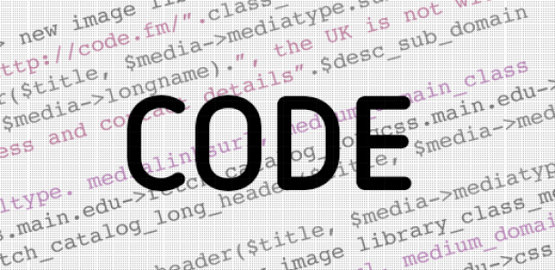
Language
Statements, Expressions and other Concepts
TCL
TSL
Statement
  Composed of Words
    First Word is Command
    Rest is Command Macro Params
Expressions
Things
  Scalars
  Key-Value Containers
Statement
  Composed of First Word and Rest
  First Word is Message
    Command, Function or Method
  Rest is Message DSL Params
    Literal, Macro, Eval
Things
  Scalars
  Mixin Prototype Dynamic Objects

Slide 9
Operators and Keywords
Syntax, Semantics and DSL patterns
Operator Language Type Patterns
{…} tcl Literal text patterns.
"…" '…' `…` tcl+ Macro prefix-names. $(…), $[…], ${…} forms. (…) invocation. Quirks for "[…]".
[…] tcl† Command proc, func, method patterns. Unary and binary symbol method patterns.
(…) tsl Expr (eval) implicit eval pattern.
--
$ tcl+ MX path Operator macro-expand operator for variables and other tokens.
& tsl Ref path Operator reference operator for variables and path expressions.
--
\ tcl+ Escape Operator enables UTF8, ascii and inline-operator escapes.
; tcl † End-of-statement TCL quirks mode for newline and curly-brace EOS.
, tsl End-of-expression Expr eval param delimiter.
--
# /* */ // tcl+ † Comments JavaScript/C++ compatible comments. Quirks for TCL #.
Keywords Description
super this † tsl inheritance operator and contextual variable for accessing inheritance and behavior properties. Within command declaration: this, …, args, *, &, ^.
@ tsl identifier character whose usage rules are restricted to rules defined by the language system.

Slide 10
Command re-examined as Message
statement
word-tokens: literal, macro-forms
$ "…" […] {…}
Command
Params (aka words)
putl $msg; # A TCL command with macro-param
putl(msg) # A TSL function with expr-param
stream.putl(msg); # A TSL method with an expr-param
stream.putl() $msg; # A TSL method with a macro-param

Slide 11
Variables re-examined
Declaration
set varName valueParamWord; # TCL assignment form
set varName; # TCL get command
var varRef = eval-expr; # TSL assignment form
var varRef; # TSL decl command form
Variable Reference is a path
Path roots are:
Global, or in Stack Frame Context down-level of global-root-frame.

Slide 12
Variable Path Expressions
JSON Expressions and TCL quirks mode support
…
$ & :: identifier . (…)
&& ^ {…} ::
. […]
Examples:
$[putl "Hello"]¹ ${putl "Hello"} † $(17 + 5 % 3)³
$::identifier-expr $^identifier-expr $identifier-expr
$identifier.{literal-key}.[expr-key] $a.b[3] $a::b[3] $a.b::[3] $a{b}[3]["z"]
$receiver-path-expr::namespace-expr(?invoke-expr-param?, …)
Cases of Note:
&{ … JSON pojo … } JSON pojo supporting TSL eval expr extensions and auto-conversion.
&[ … JSON poja … ] JSON poja supporting TSL eval expr extensions.
var identifier-path = &&var-ref-path; Binds two variables, as opposed to assignment.

Slide 13
DEMO
var sharing
Script Example

Slide 14
Object Model
Object
Logically, objects reference other objects using key-value associations which can be shared. An association can also be called a variable.
Header
C/C++ Structured Storage
Slots
TSL variables and commands play a key role in how
perspective types are used for versioning and dynamic security
In practice, the internals are more highly optimized and only used associations as an object proxy indirection when sharing requires it.
Variable (aka Association)
ObjRef’s are tagged pointers. Certain scalar values, like IntPs objects, actually have their value encoded directly in the pointer.
Key
Symbol
Value
ObjRef
Expando Type
proto-super
mixin behavior
Object
Object
Header
C/C++ Structured Storage
Slots
Header
C/C++ Structured Storage
Slots

Slide 15
Object Space
One per engine created within a process.
There can be an unlimited number of engines within a process. Each engine takes microseconds to create or release.
The variable predicate path-binder plays a key-role in mixin and path resolution
Global Root
::system
::system::info
Stack Frame
By default, proc declarations are placed here.
#1
thisFrame
::system::commands
Stack Frame
#2
thisFrame
Stack Frame
While crucial concepts, as we will see next, the DSL for intrinsic command declaration constructor forms mean that upvar and uplevel are rarely needed.
thisFrame
#3
By default, func declarations are placed here.

Slide 16
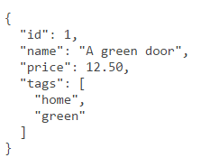
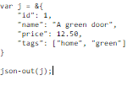

JSON
Given a uniform internal object model, all objects can be converted to or from JSON via serialization.
The original technology name for this in AOS 1992 was PIPOs. Platform Independent Portable Objects, which contained TOCs, DBs, versioning, schema-migration features and supported cross-machine migration of threads and UX components with automatic re-wiring.
When TSL networking protocols for HTTP/HTTPS with JSON are combined with SQL TRIGGERS in SqLite using JSON1, powerful robust systems can be easily built.
Object
Object

Slide 17
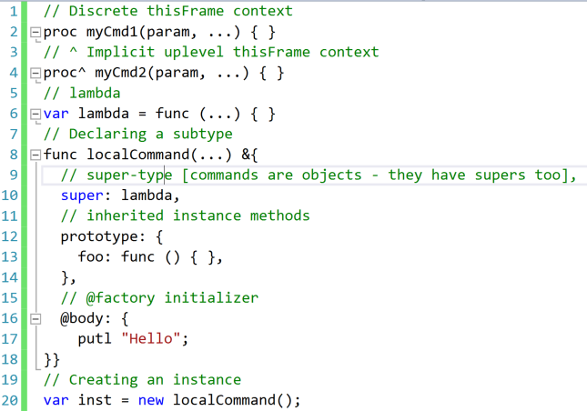
Commands are objects
Scripts are lambda commands
Modules are commands with additional metadata.
Source has provenance, which plays a role in perspective-type binding of versions and access security.
Since objects are pathable and commands are global or contextual objects, commands are commonly used as namespaces.

Slide 18
QUESTIONS
More demos
offline and BOF

